Slide 1
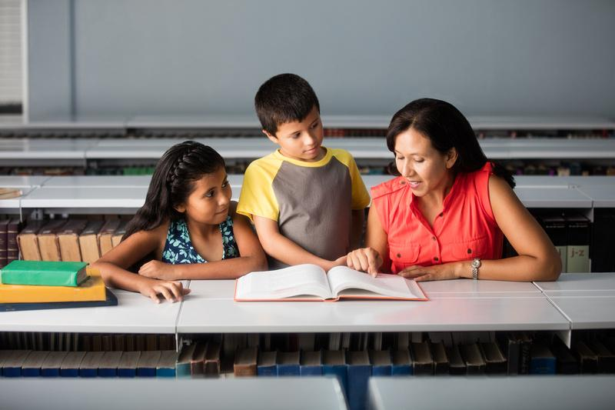

Inventing, Designing, and Engineering for All Students
Imagine what a library can be
DISCOVER
Notes:
Georgette
Hi everyone. Thank you for joining today’s webinar, Inventing, Designing, and Engineering for All Students
.
As always, we’re going to give everyone a few moments log in and get settled. You’ll also notice the chat panel at the bottom of your screen, make sure you are sharing with All Attendees and Panelists and let us know where you’re joining from today.
As everyone gets settled in and navigates to chat, we wanted to share a brief video with you all.

Slide 2


Slide 3
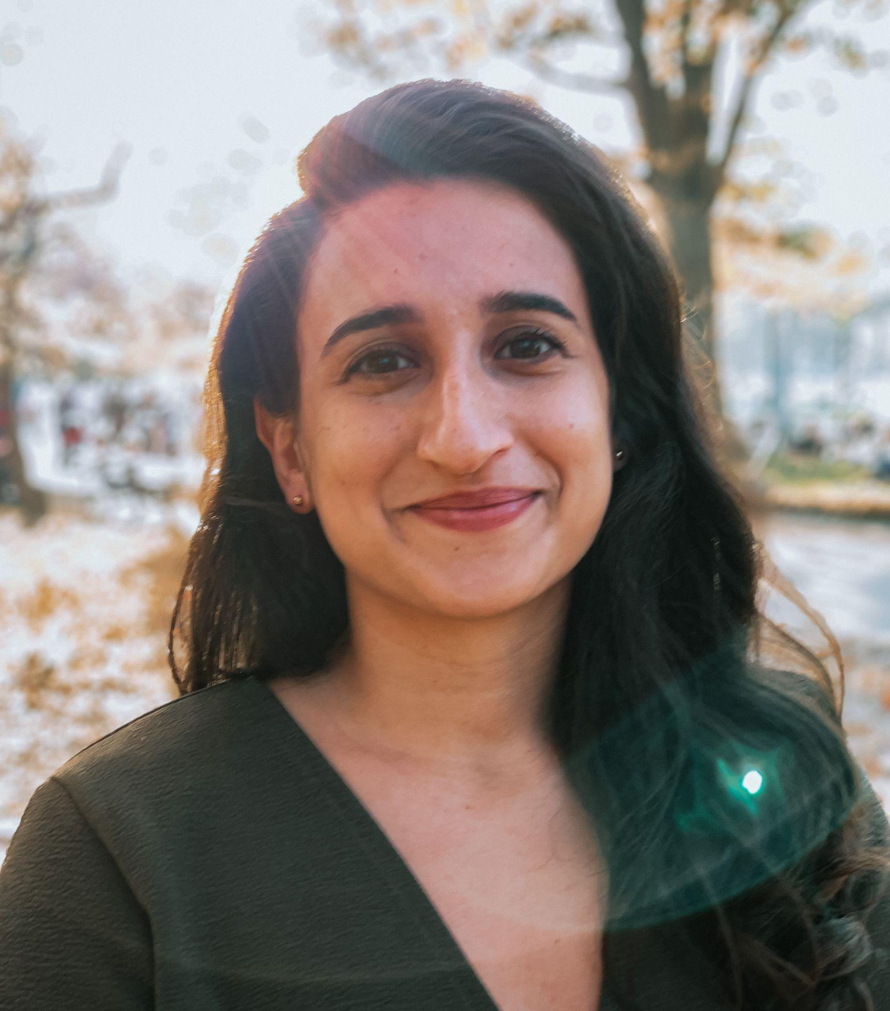
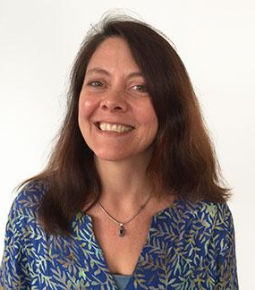
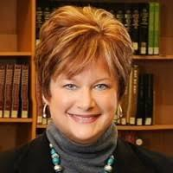
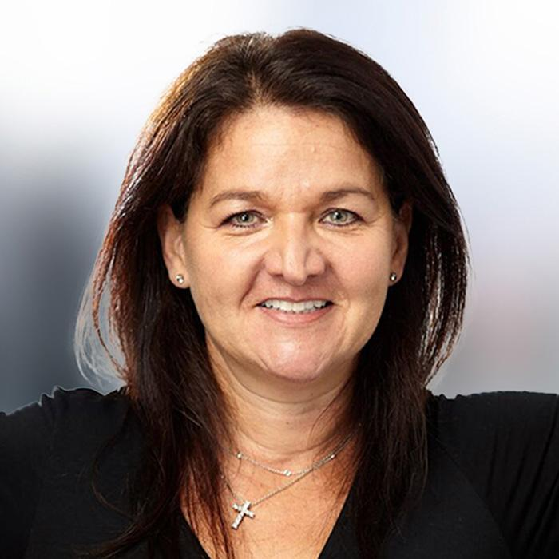
ARIANA RICCIO
WENDY MARTIN
GINA MILLSAP
GEORGETTE KENNEY
Senior Research Associate
EDC
Senior Research Scientist
EDC
Former CEO
Topeka & Shawnee County Public Library
VP of Corporate Marketing Bibliotheca
Notes:
Georgette
Again, welcome to anyone just logging in.
Today, it’s my pleasure to welcome Dr. Ariana Riccio Senior Research Associate at Education Development Center. Her work focuses on curriculum development, maker education, and transitions to employment and higher education for autistic adolescents and young adults. Her research aims to improve resources and programming for autistic youth and those with other developmental disabilities. Dr. Riccio has a BA in Biology and Community Health from Tufts University and a PhD in Development Psychology from the Graduate Center of the City University of New York. It’s a pleasure to have you here Ariana.
It is also my pleasure to welcome Dr. Wendy Martin. Senior Research Scientist at Education Development Center. Wendy’s work includes projects that focus on co-designing STEM programs with neurodivergent youth and formal and informal educators, and collaborations across multiple out of school time program providers to develop STEM career pathways for youth. Projects she works on are funded by the National Science Foundation. NASA, and the LEGO Foundation. Thanks for joining us Wendy
I'm also excited to welcome Gina Millsap, Former CEO of Topeka and Shawnee County Public Library. We thought it would be more engaging to have the discussion moderated by her, as she has over 40 years of library experience under her belt and can help lead a discussion of the ideas that Jo and Amy will share. As always, thanks for leading the discussion today, Gina!
I’m Georgette Kenney, Vice-President of Global Marketing here at bibliotheca and behind the scenes, we have our Marketing Team and John Parris from EDC making sure things run smoothly. You may see them sharing links in chat or answering technical questions you may have.​ We will share the chat log and presentation with everyone, so please feel free to engage and know you’ll get a copy of the information shared. One more reminder to make sure you’ve switched your chat settings to engage with All Attendees and Panelists. ​We will have time for live Q&A at the end of today’s webinar, so if you want to raise a question, please use that function. You can upvote other submissions as well, so we can raise the most relevant conversations. ​
With that, it’s my pleasure to hand things over to Gina​.
​
[Transition to Gina]

Slide 4

Making at Libraries
Libraries have a long history of hosting maker programs
This includes programs focused on hands-on crafting
Today, we’ll discuss how libraries can broaden the scope of maker programs available at their locations

Slide 5




NSF Award #s DRL-1614436 and DRL-1850289

Slide 6
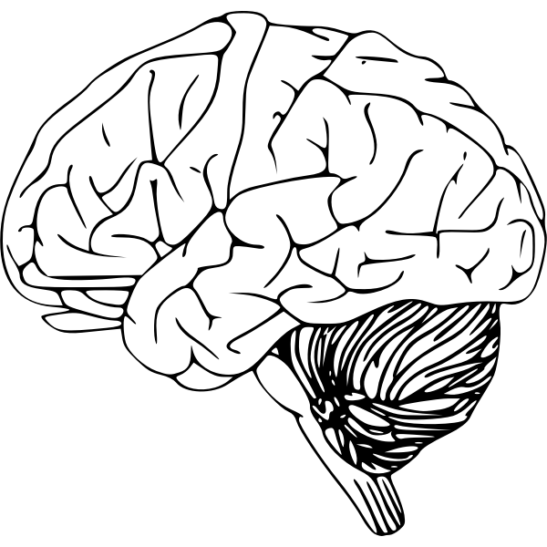
What is Neurodiversity?
Neurodiversity is the diversity of human brains and minds. Neurodiversity is a natural and valuable form of human diversity
  The idea that there is one “normal” type of brain is an unhealthy, culturally constructed fiction
  Similar social dynamics manifest in response to neurodiversity as to other forms of human diversity (e.g., ethnicity, gender, or culture), including power inequalities or embracing diversity as a source of creative potential.

Slide 7
What is autism?
Autistic people may experience difficulties with social communication and have “restricted, repetitive patterns of behavior and/or focused interests.” (APA, 2013)
While these core features are consistent for all diagnosed as autistic, autistic individuals present with a wide spectrum of differing strengths and support needs.
Autistic people often express their focused interests through a systematic approach to learning and a strong affinity for computers, mathematics and science. (Baron-Cohen, 2009; Jordan & Caldwell-Harris, 2012)

Slide 8
Poll:
Do you have experience working with young people on the autism spectrum?

Slide 9
A note about language:
"Autism isn’t something a person has, or a “shell” that a person is trapped inside. There’s no normal child hidden behind the autism. Autism is a way of being. It is pervasive; it colors every experience, every sensation, perception, thought, emotion, and encounter, every aspect of existence. It is not possible to separate the autism from the person–and if it were possible, the person you’d have left would not be the same person you started with.”
- Jim Sinclair (1993)

Slide 10
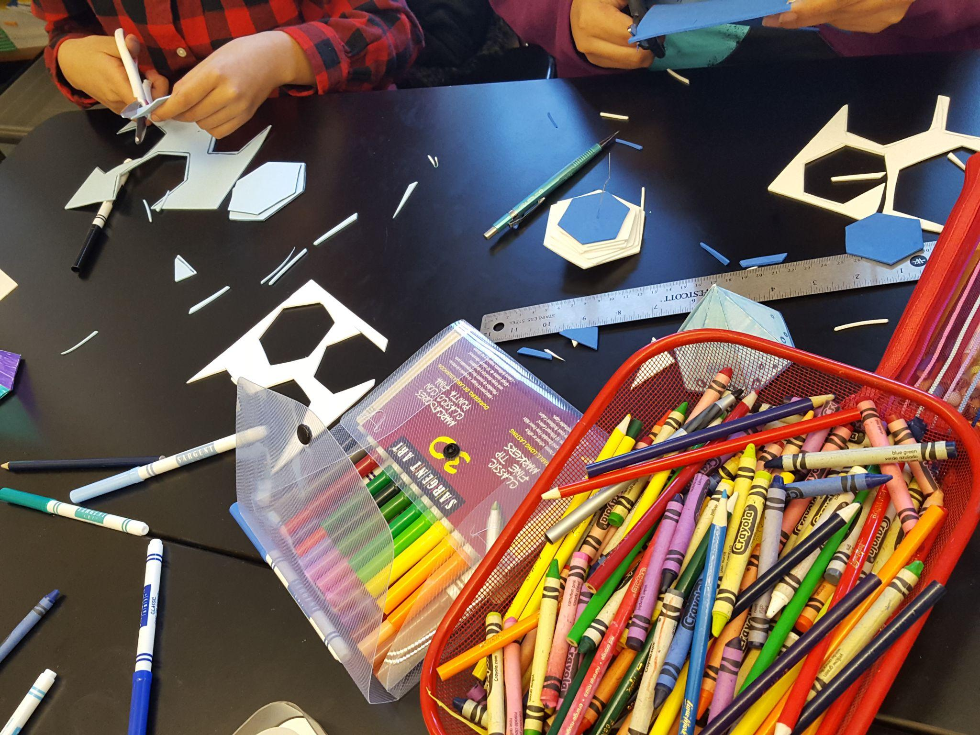
The Need
The employment outcomes of autistic people often fail to reflect their potential.
A national survey found that 44.9% of autistic youth had never obtained any form of paid employment in the 6 years after high school (Shattuck et al., 2012).
Autistic students who do attend college major in STEM at higher rates than other students (Wei et al., 2014).
There is sufficient and growing evidence that shows academic difficulties are often not the cause for autistic students’ lower rates of college enrollment, completion, and workforce readiness.

Slide 11
Poll:
Do you have experience hosting maker programs or with maker spaces?

Slide 12
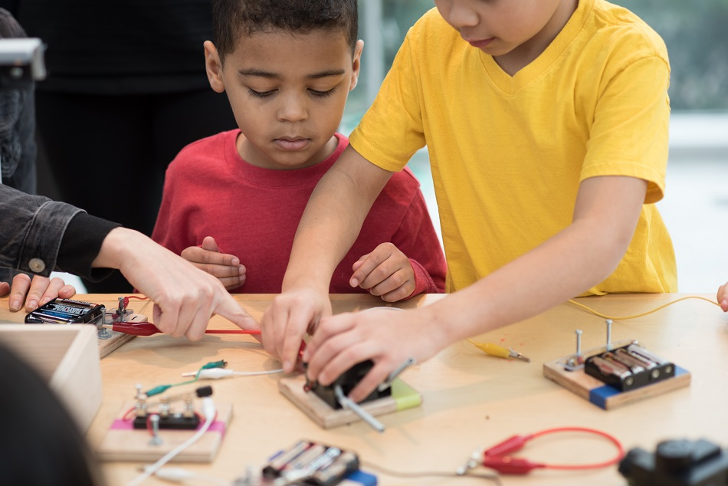
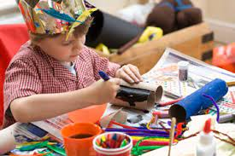
What is making and why is it helpful for autistic youth?
Making is interest-driven crafting, tinkering, building, coding, etc.
Making is iterative and oriented around process as much as product.
Making involves visual and tactile experiences.
Making allows kids to interact with peers around interests.

Slide 13
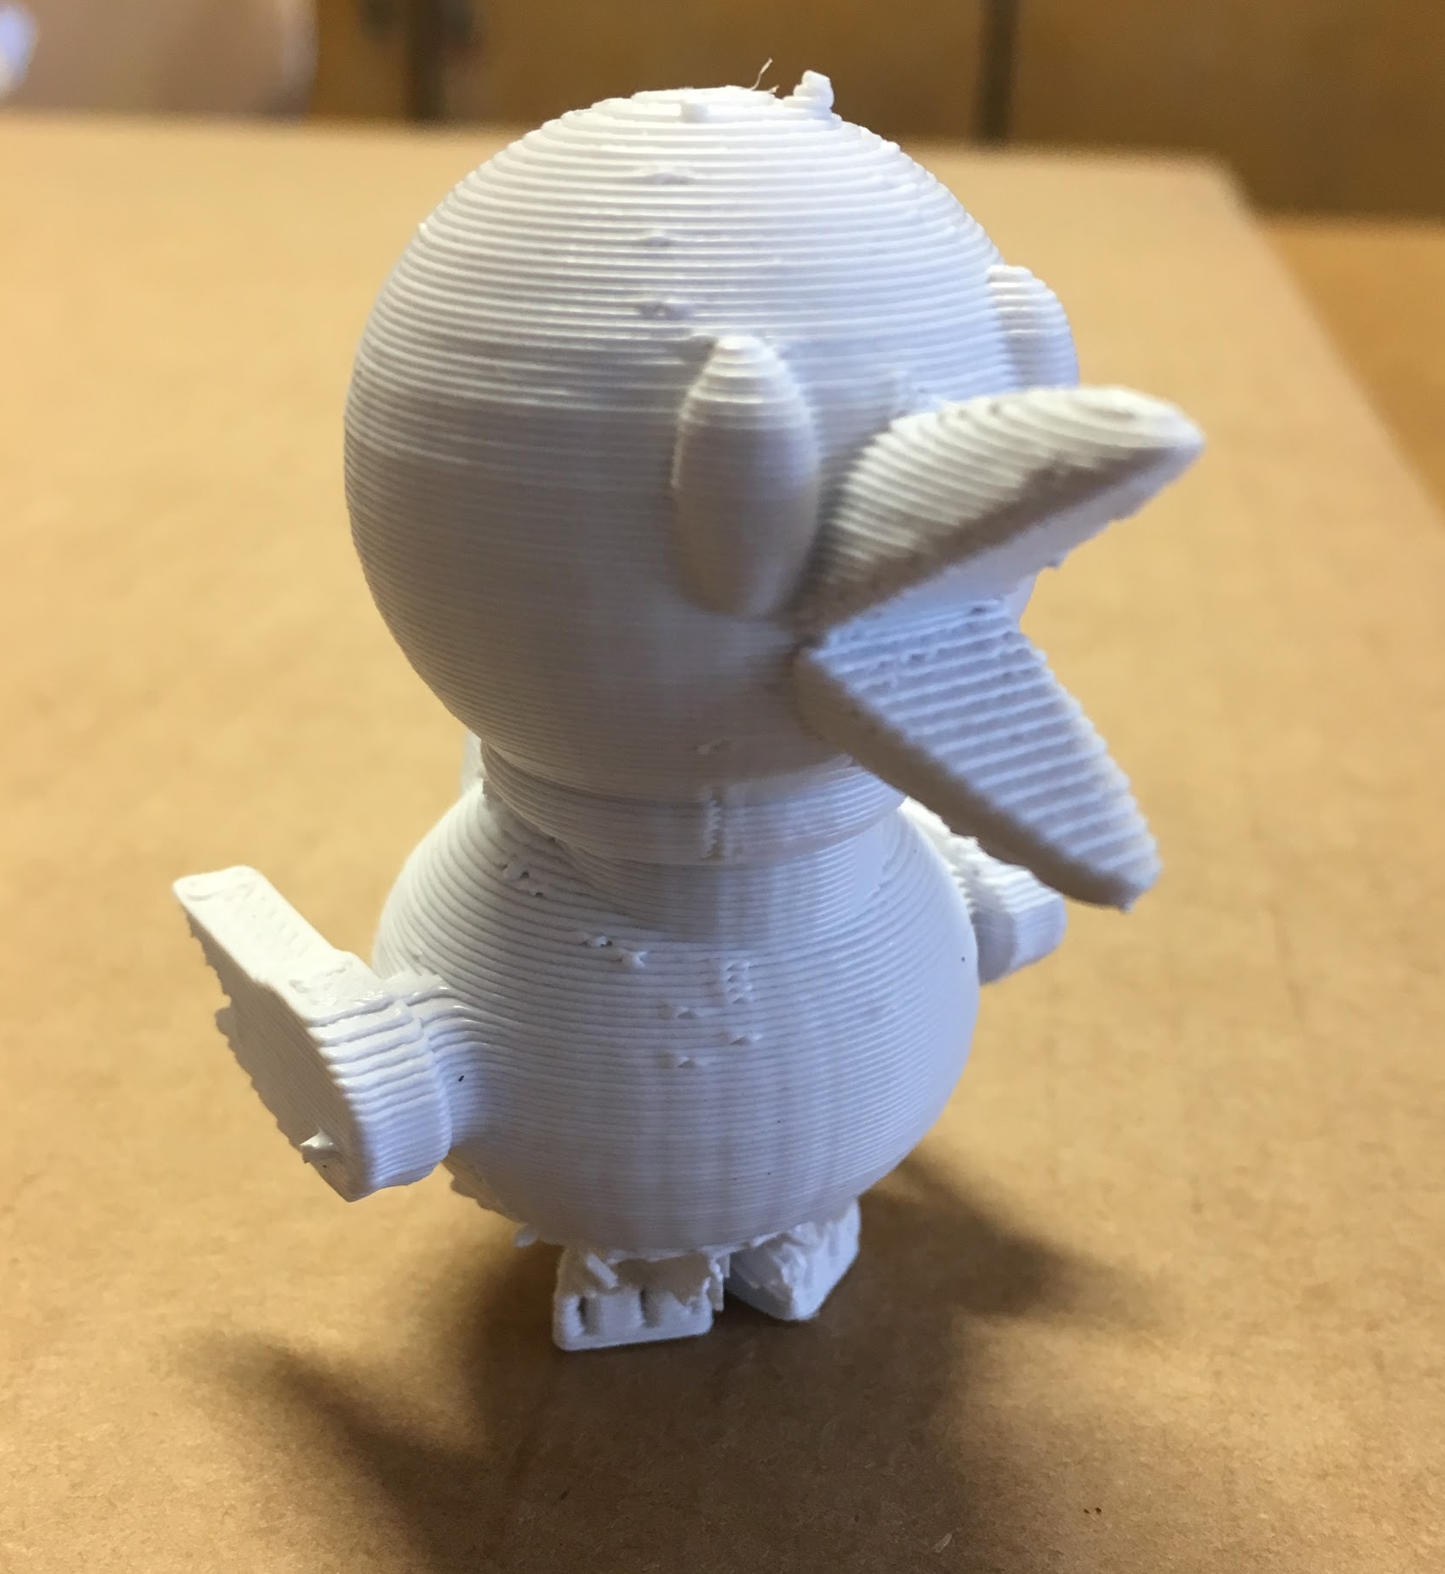
History of IDEAS 2016-2022
Collaboration among EDC, NY Hall of Science, NYU, SRI and three Nest middle schools
Collaboratively adapted NYSCI’s 3D Design and Fabrication maker program to be run by Nest teachers or service providers as an afterschool or lunch time program.
Our curriculum is available open-access at bit.ly/IDEAScurriculum
We have scaled to elementary and high school.
Because of COVID, we created materials for remote versions of the program.
Notes:
https://www.edc.org/ideas-inventing-designing-and-engineering-all-students-maker-program

Slide 14
Goals of the IDEAS Maker Program
Enable learners to engage with the Engineering Design Process (EDP)
Allow learners to pursue their own interests
Support social engagement among makers in an inclusive setting
BRAINSTORM
IDEAS
MAKE A
PLAN
START
IDENTIFY
THE
PROBLEM
PROTOTYPE
FAILS
MAKE YOUR
PROTOTYPE
ITERATION
IMPROVE
OR
FINALIZE
TEST YOUR
PROTOTYPE

Slide 15
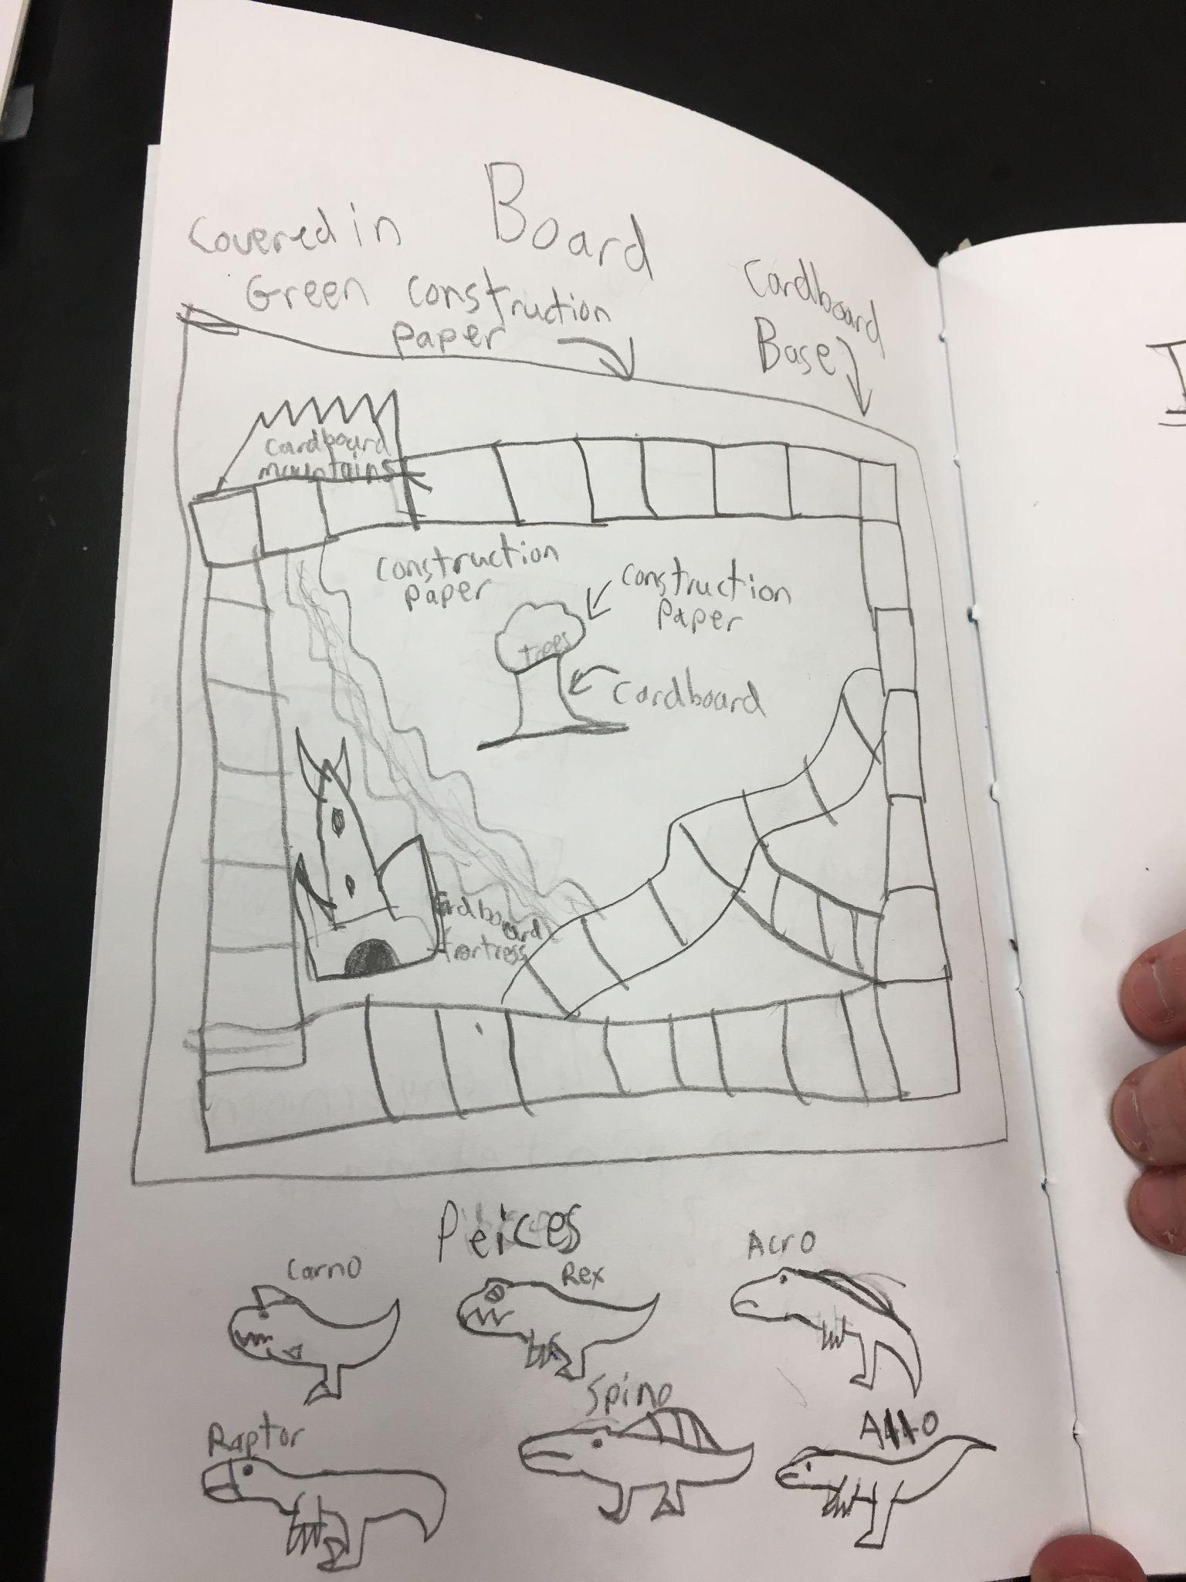
Research on Making in Nest Schools
All students learned the engineering design process and demonstrated high level of interest in STEM careers by the end of the program (Martin et al., 2020).
Autistic students socialized with peers at the same rate as non-autistic students, completed complex interest-based projects and demonstrated increased self-efficacy (Chen et al. 2021).
Teacher-facilitators saw what autistic students were capable of when not in formal classroom settings.
15

Slide 16
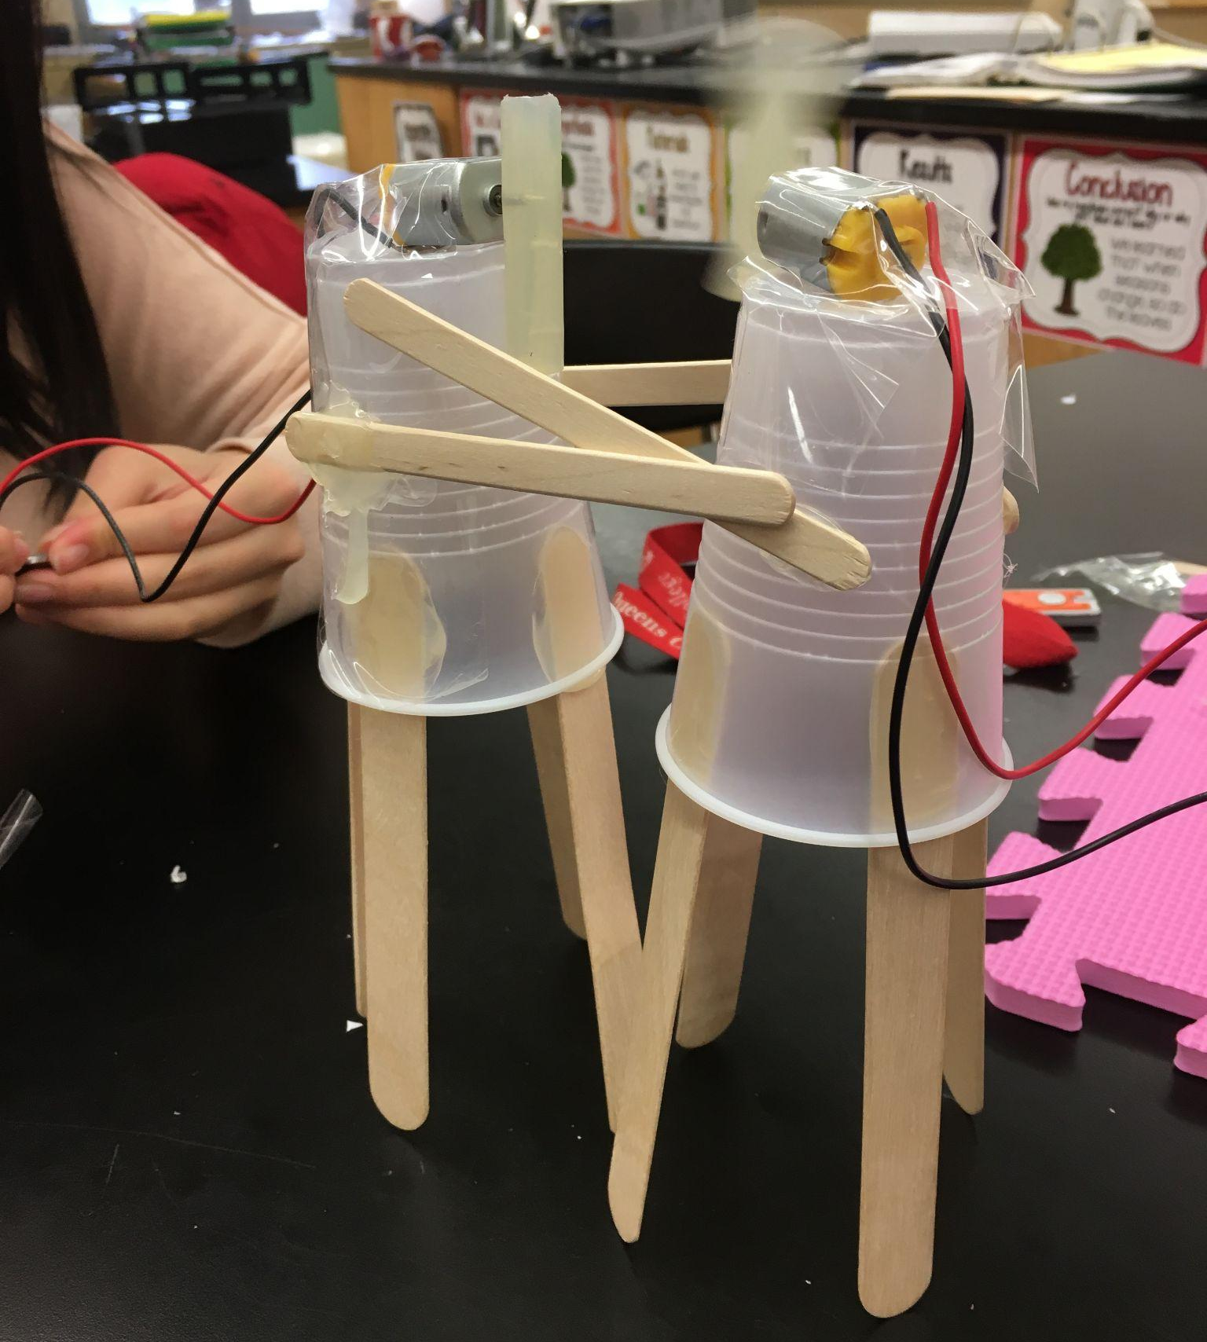
Making in Inclusion Settings
Making lends itself to universal design for learning (UDL).
Many of the characteristics of maker programming—it is hands-on, visual, kinesthetic, and allows participants to work at their own pace and express themselves in various ways—make it consistent with UDL principles.
The instructional supports we developed, such as checklists and visuals, could benefit everyone.

Slide 17
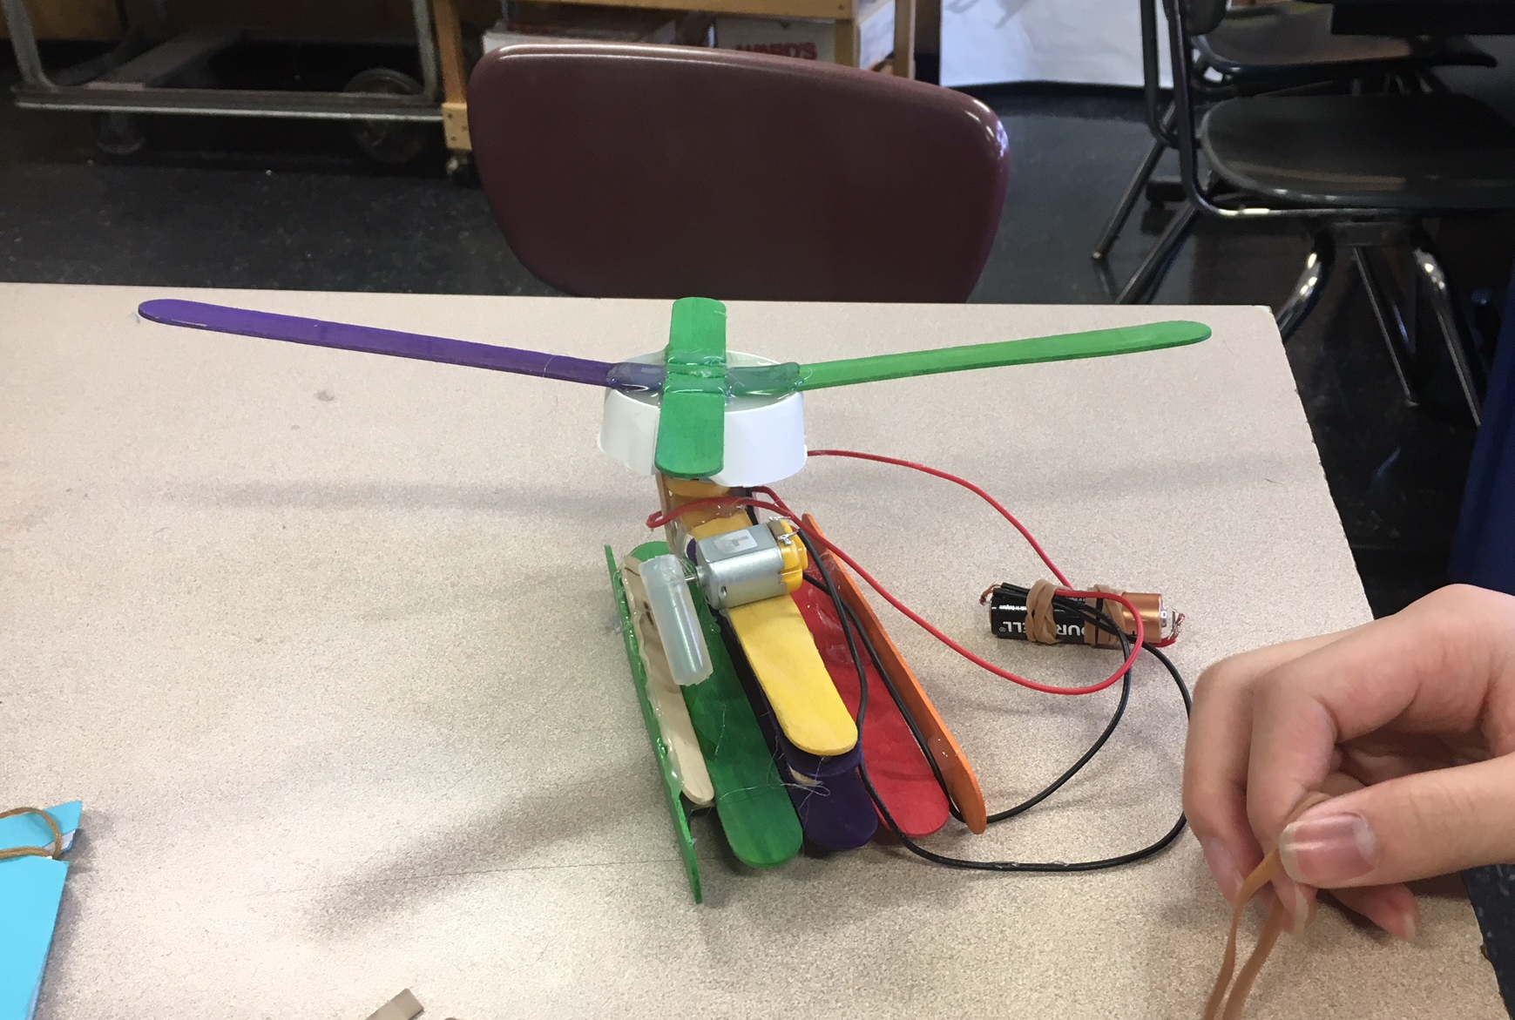
Stories of Student Growth
Robert spent science class constantly asking questions related to his own interest in electronics
Once in Maker Club he could “save up” questions and ask them during club time
Created laptop computer as his final project.
17

Slide 18
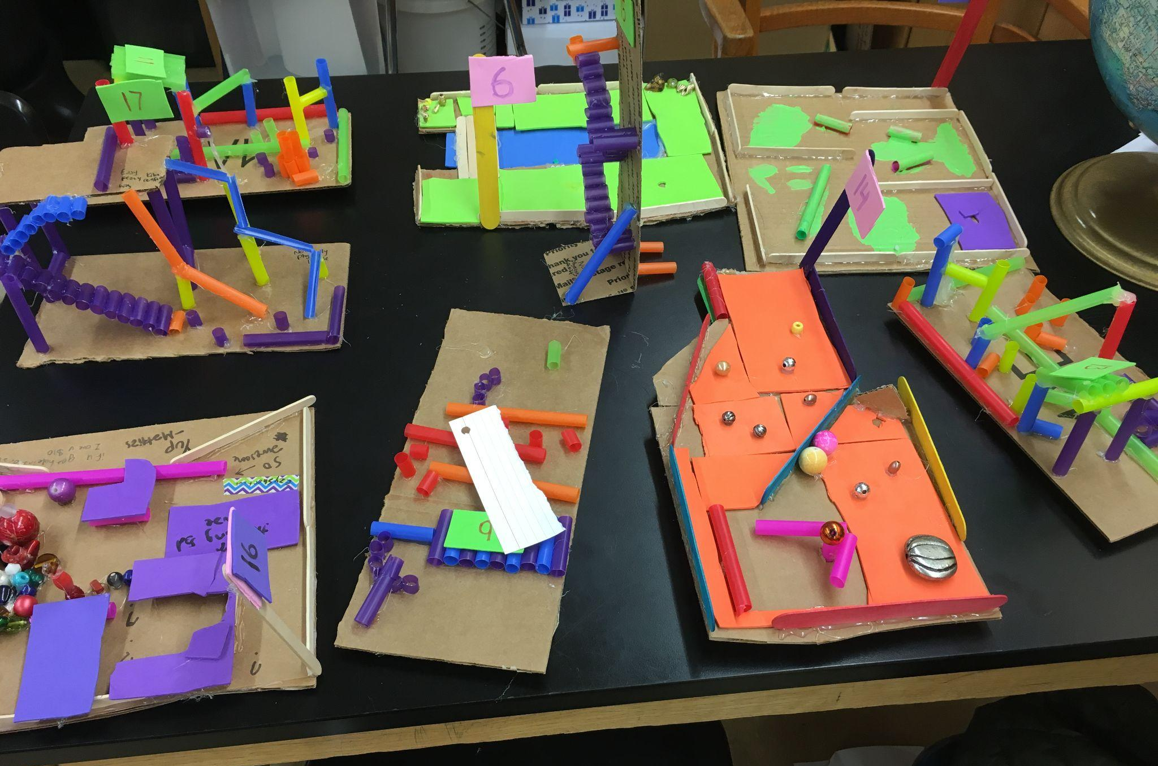
Stories of Student Growth
Cooper was socially disengaged
Spent a lot of time scripting/repeating things to himself
In class only did the bare minimum of work
Extremely productive In Maker Club
Talked with peers about the things he made
18

Slide 19
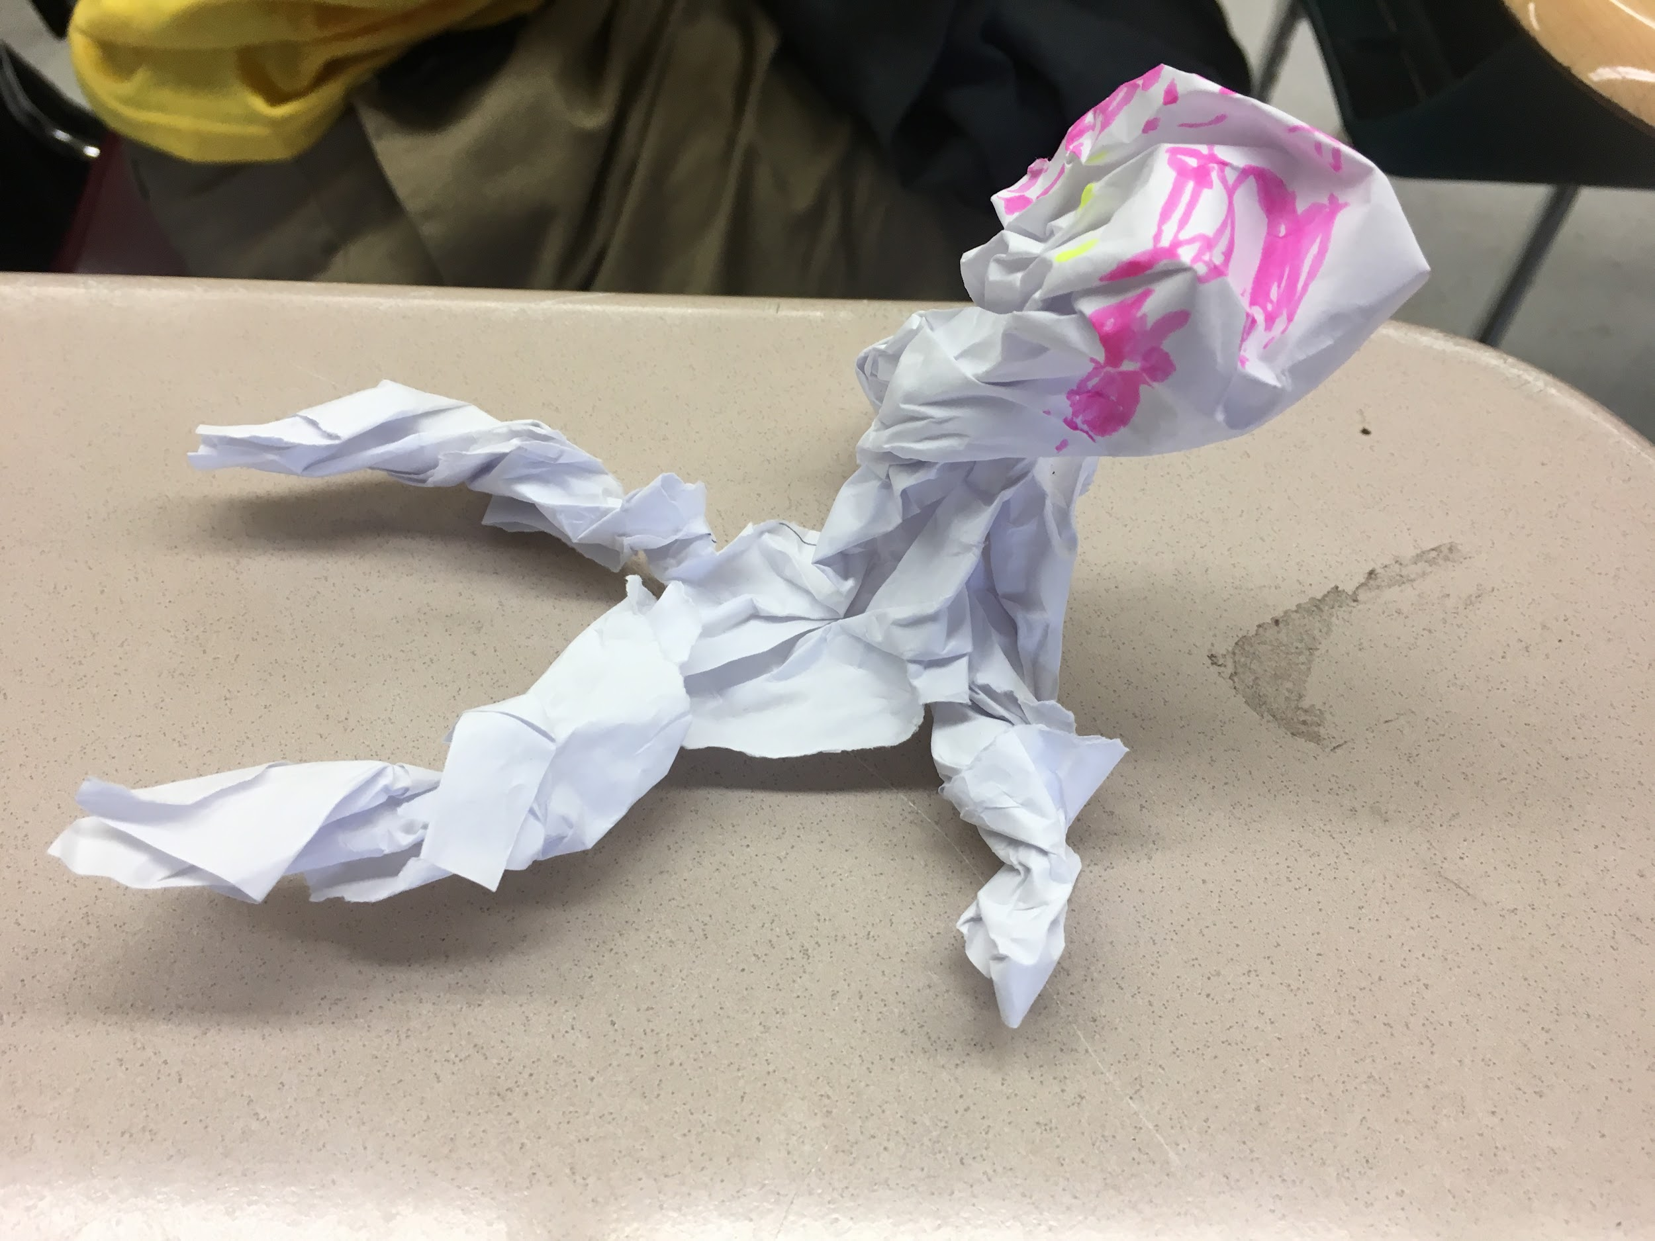
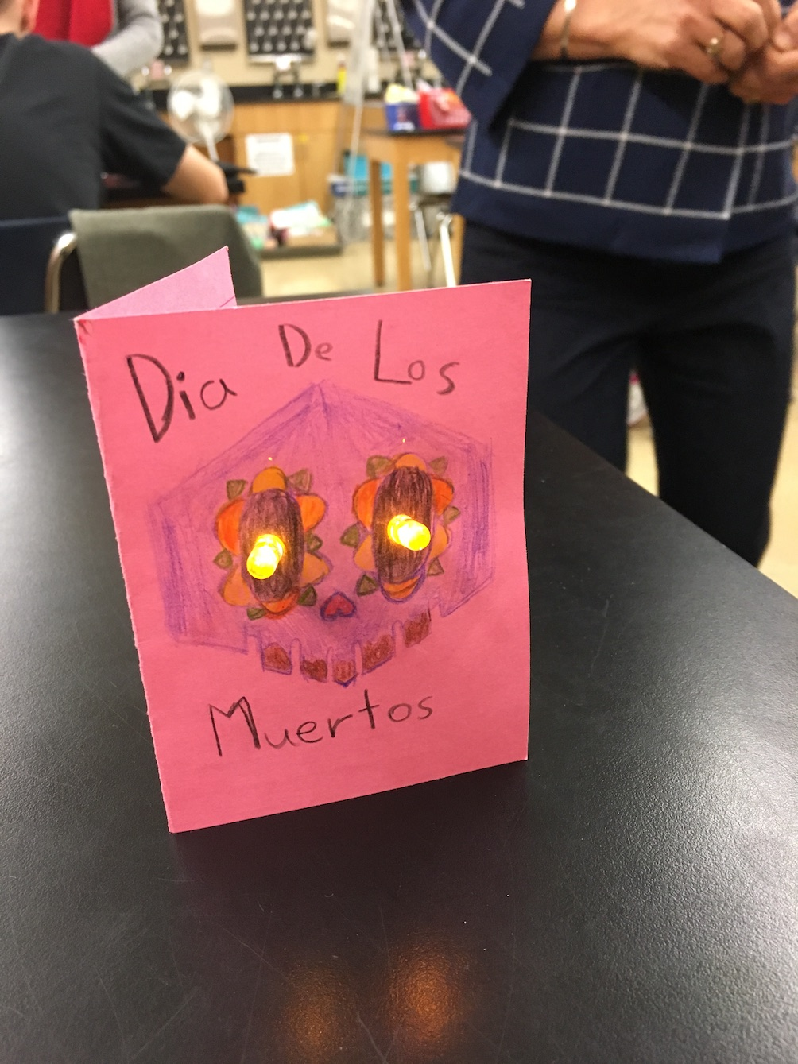
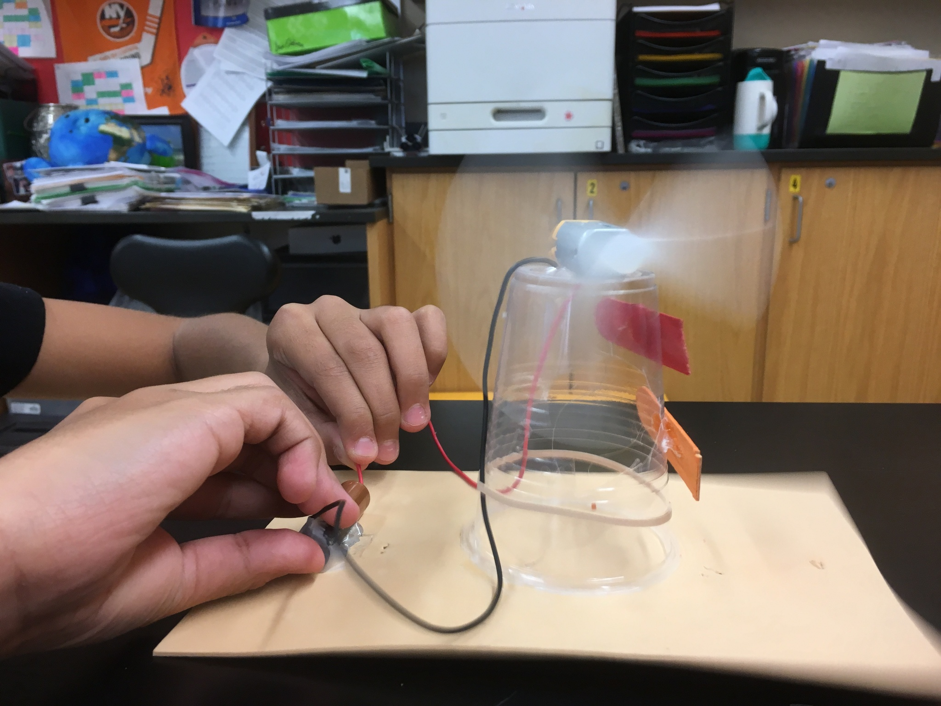
Example Maker Activities
One piece of paper
Journal making
Introduction to 3D
Motors
Circuits
LED greeting card
3D modeling in Tinkercad
Coming soon…
World building

Slide 20
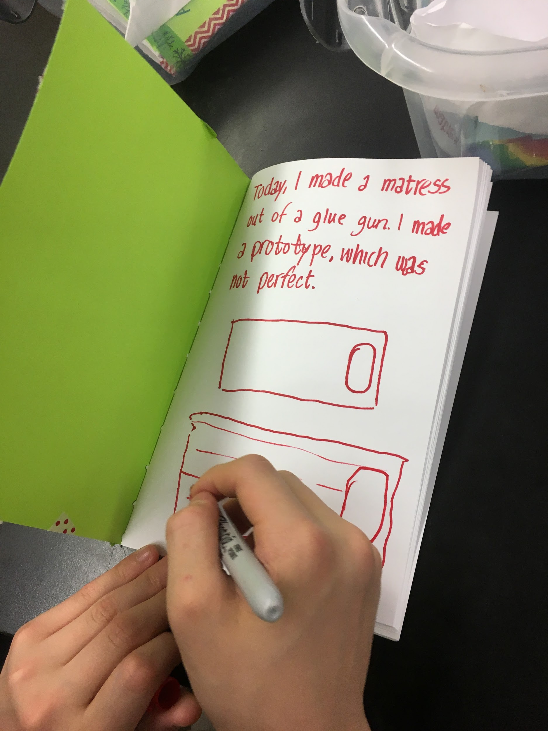
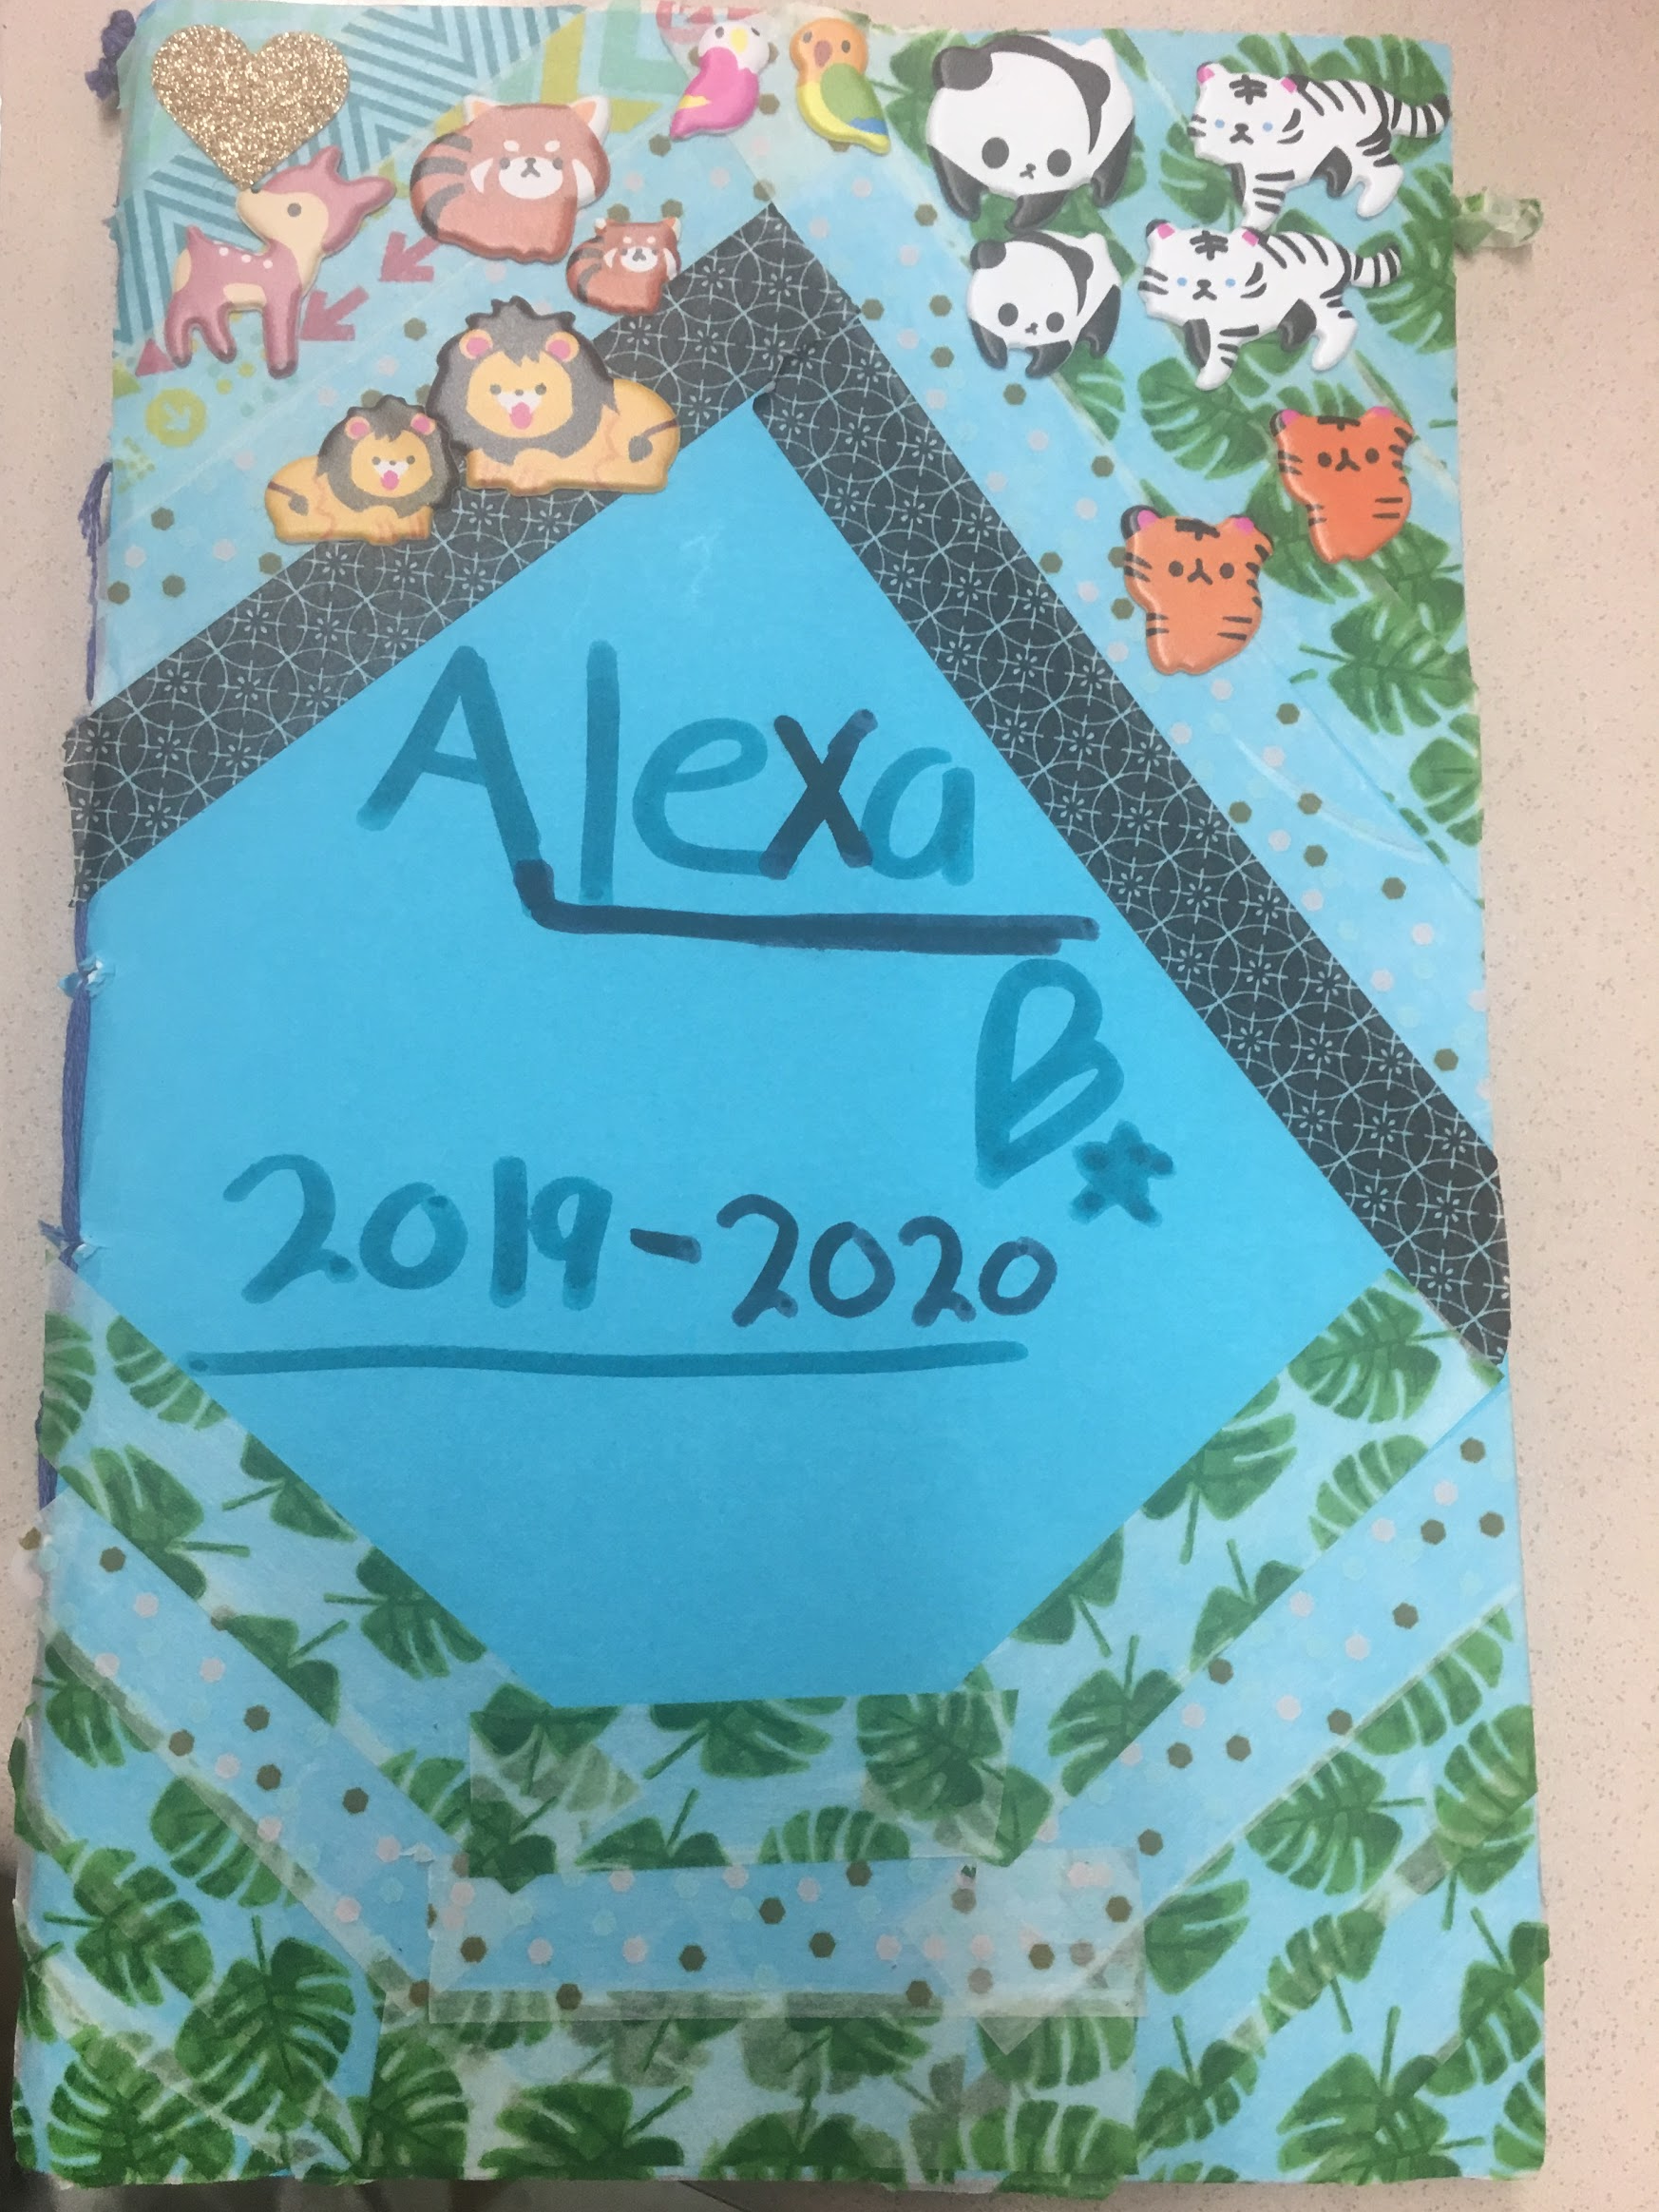
JOURNAL MAKING

Slide 21
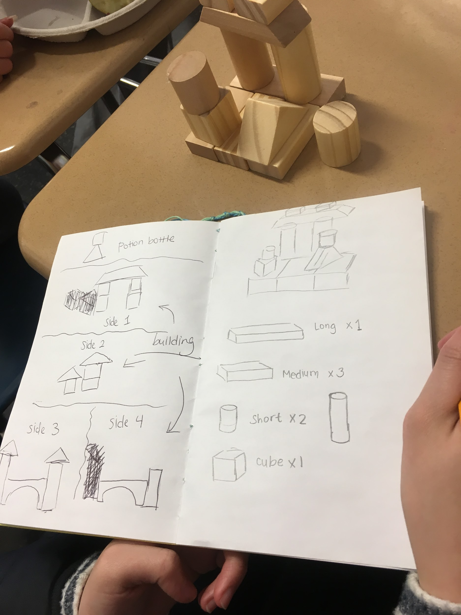
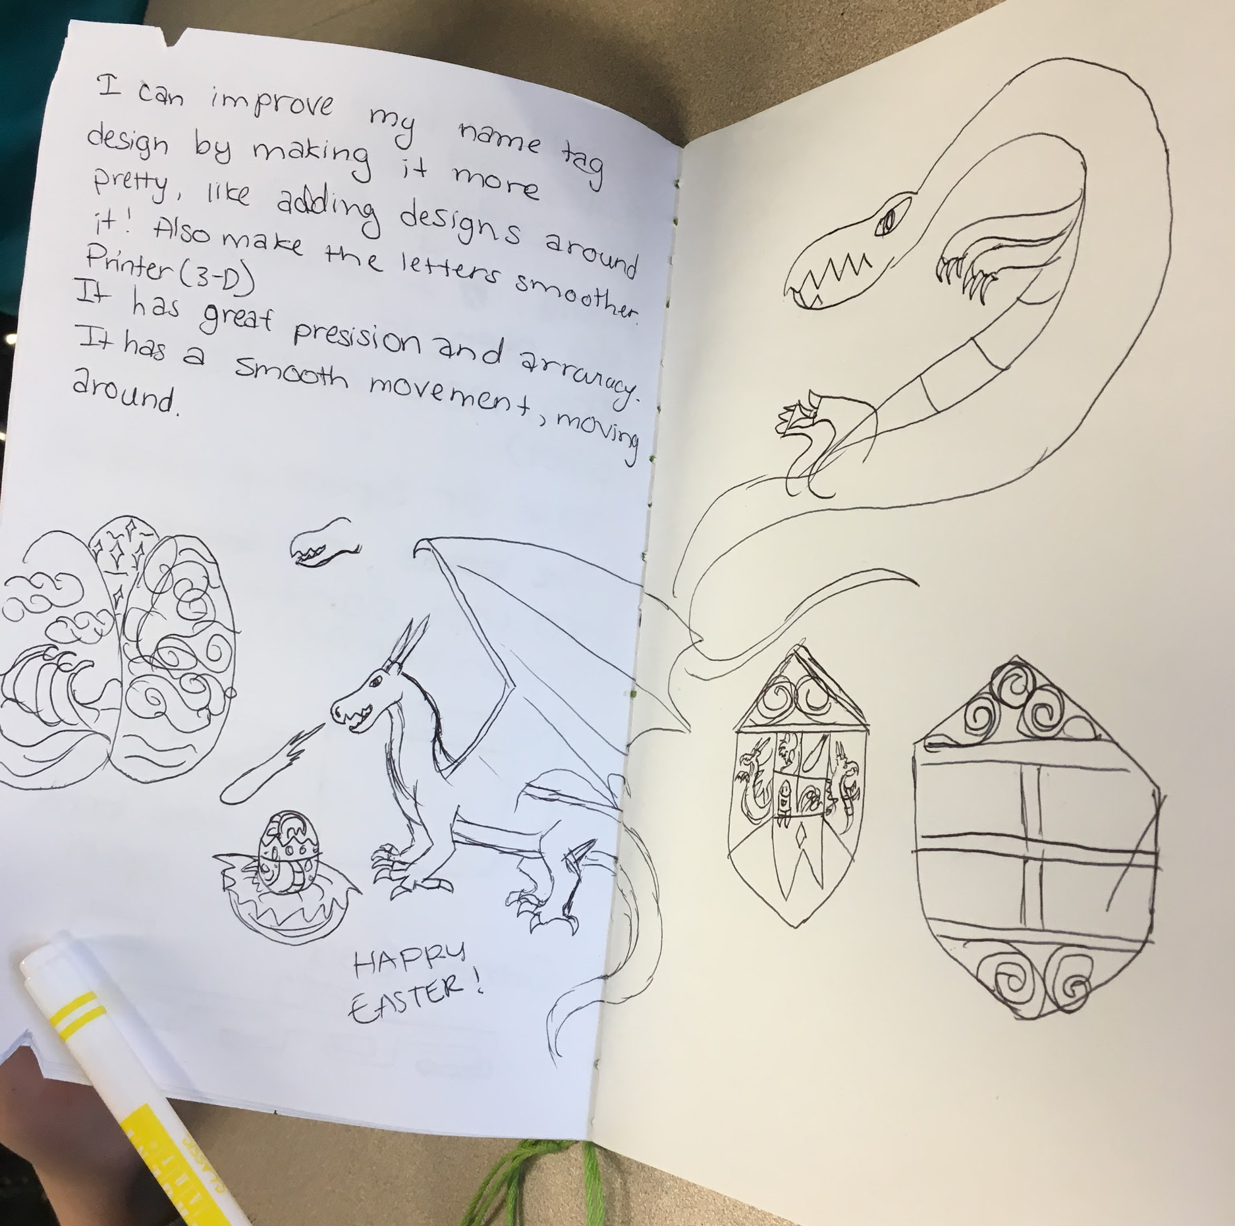
Journals
?
What is a journal?
Why do people use journals?
In Maker Club, we will use our journals to share and record our projects.
?
Notes:
And of course, as OTs, you know what else its targets... fine motor skills, visual perceptual skills, etc.

Slide 22
Materials you need today
Cardstock or colored paper
5-10 sheets of plain paper
Something to make holes (optional)
  Hammer and 1 nail
  Hole puncher
  Scissors
String, thread, or yarn
Crayons, markers, stickers, glue, beads, buttons or other craft supplies

Slide 23
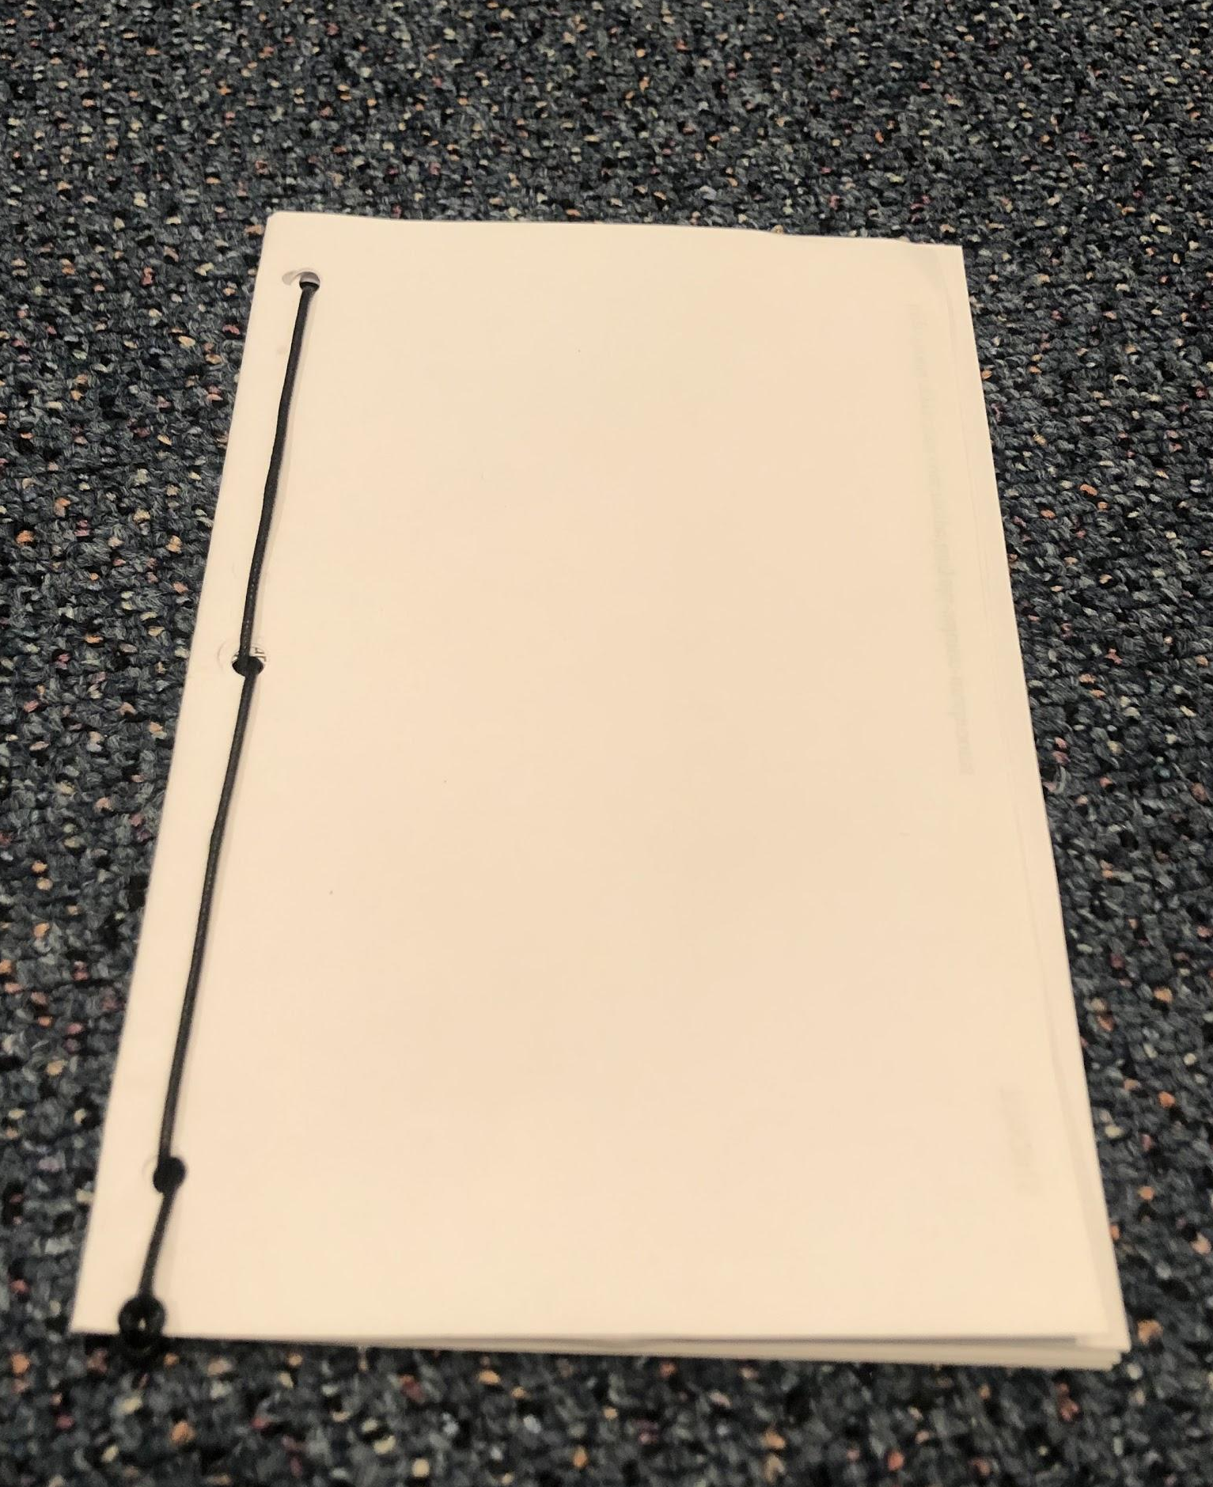
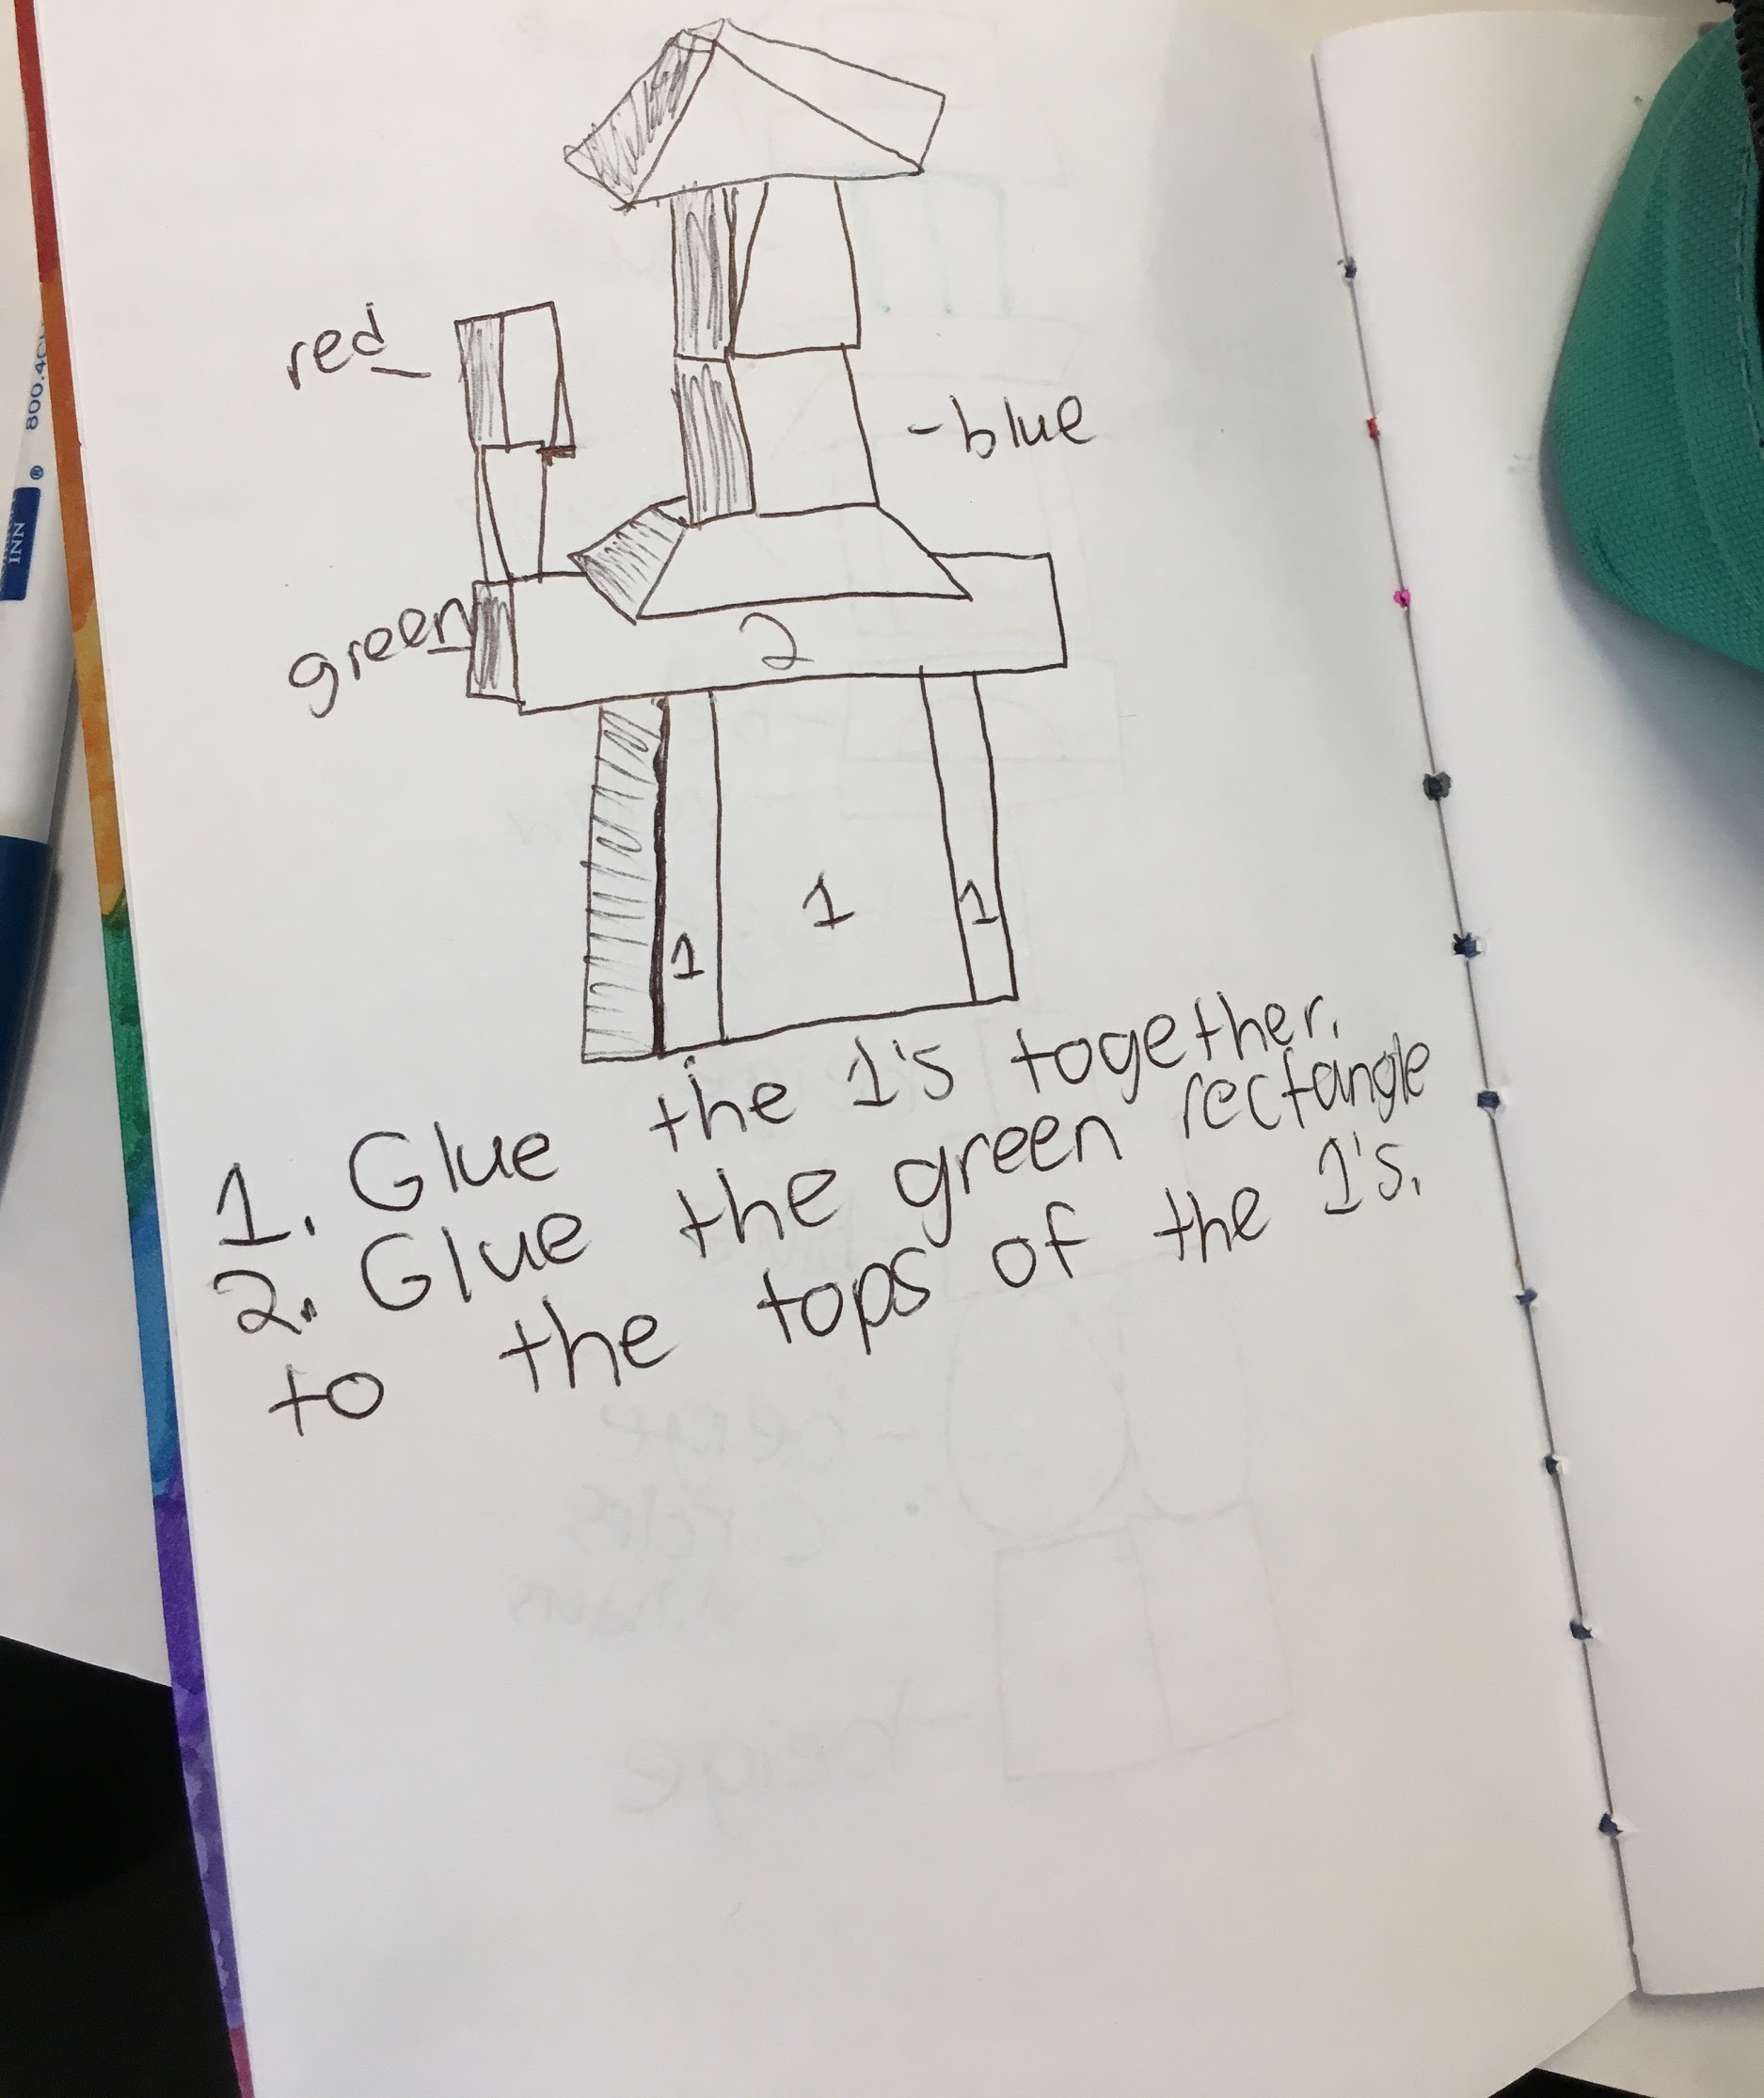
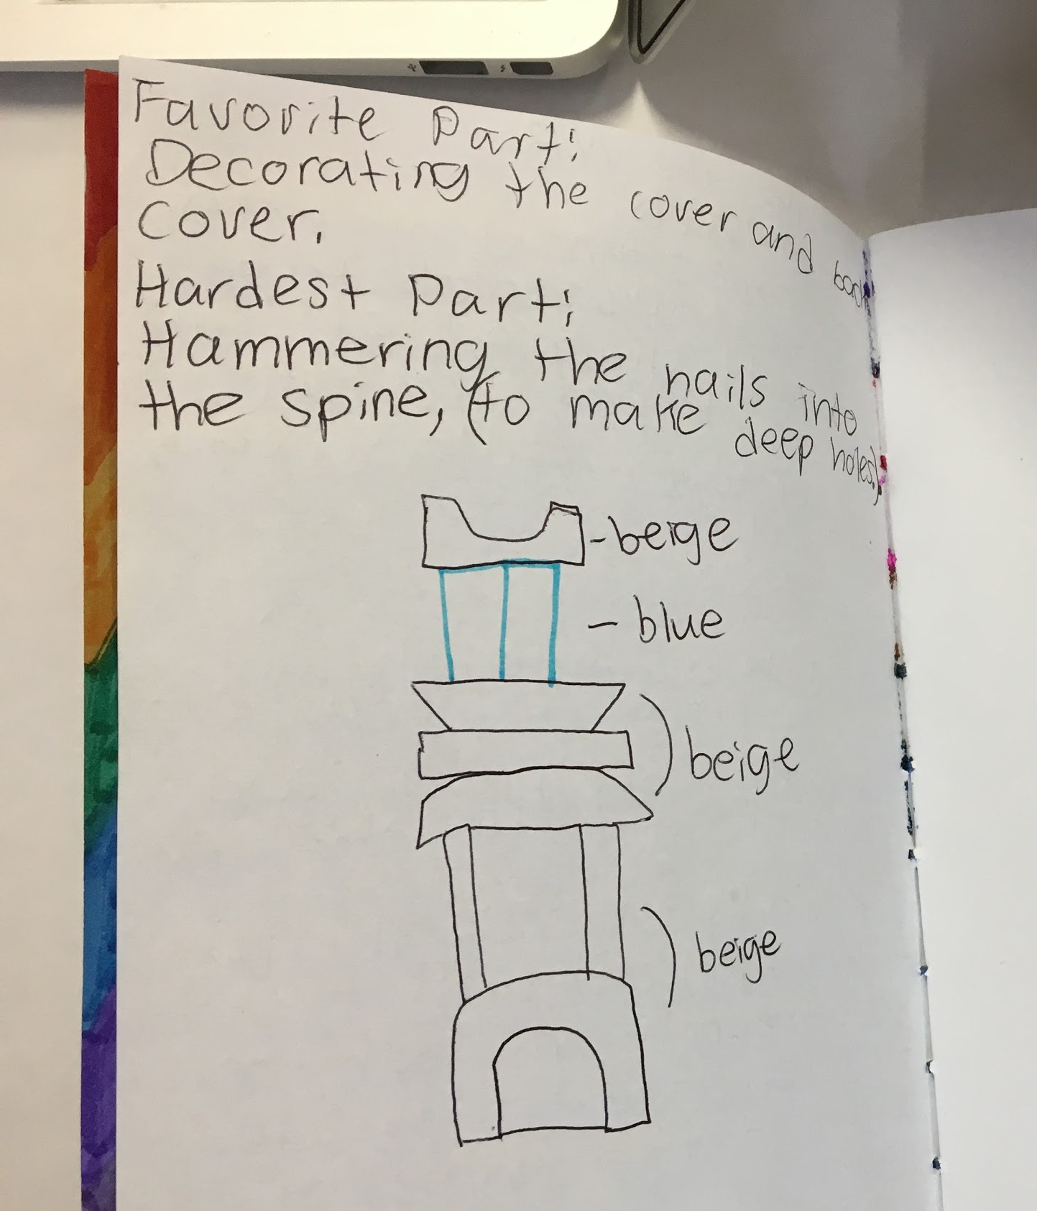
How can we make a journal?
?
What materials can we use to make a journal?
How can we put these materials together to create a book?
BRAINSTORM
IDEAS
MAKE A
PLAN
?
START
IDENTIFY
THE
PROBLEM
PROTOTYPE
FAILS
MAKE YOUR
PROTOTYPE
ITERATION
IMPROVE
OR
FINALIZE
TEST YOUR
PROTOTYPE

Slide 24
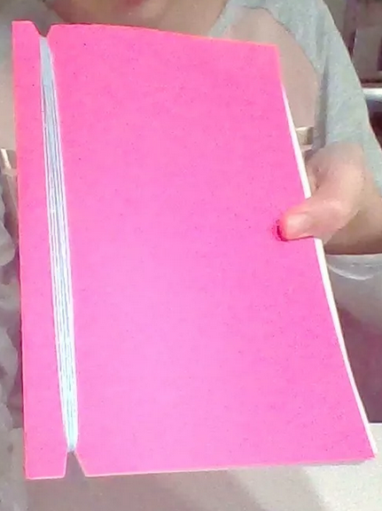
Journal Binding Method #1
Wrap Binding
How do you think you can make a wrap binding?
What materials do you need?
Steps:
Remember: this is just an example! You can use the method you think is best!

Slide 25
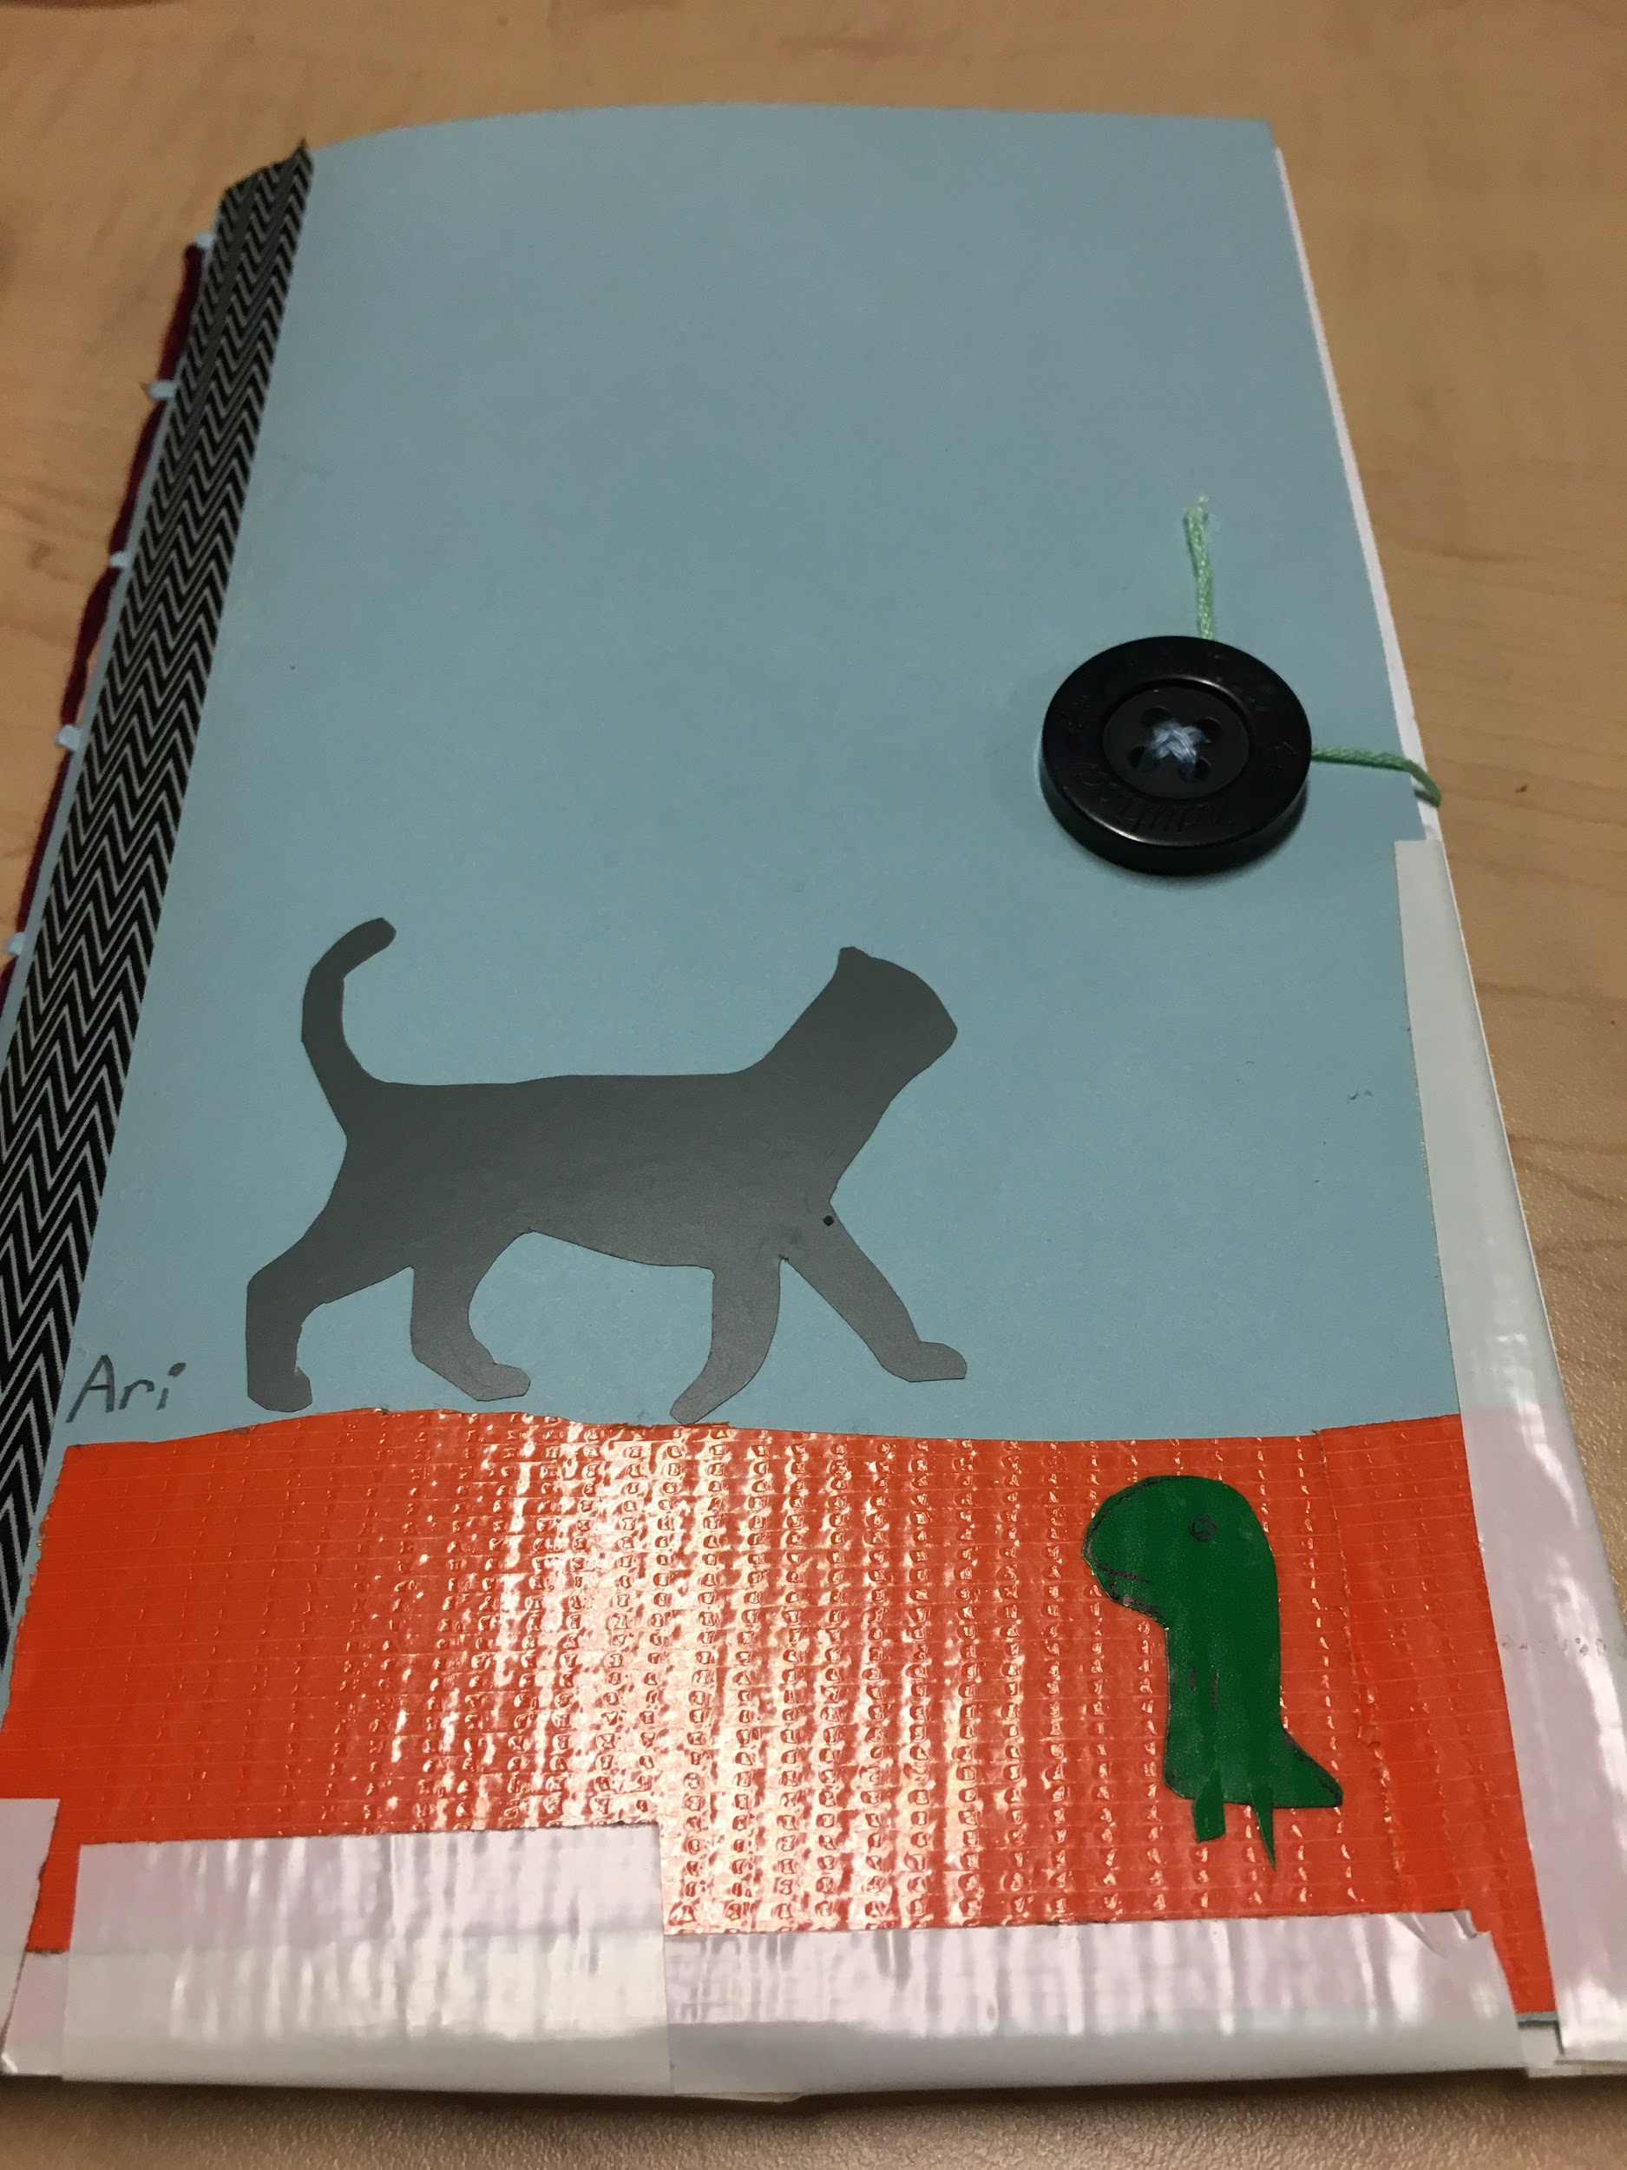
Journal Binding Method #2
Sew Binding
How do you think you can make a sew binding?
What materials do you need?
Steps:
Remember: this is just an example! You can use the method you think is best!

Slide 26
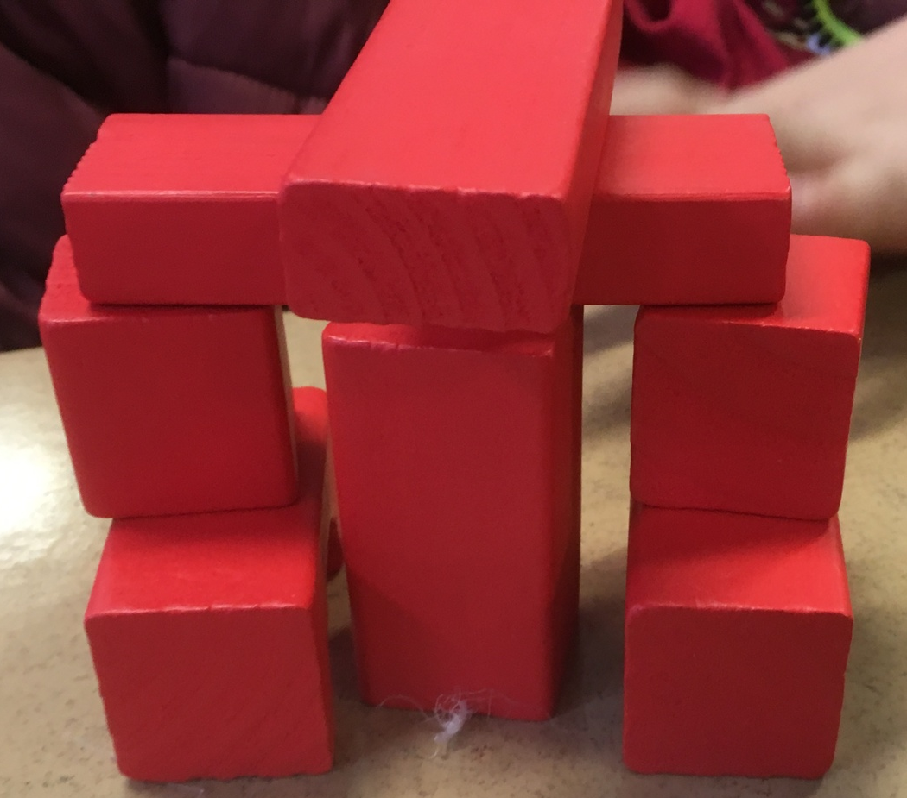
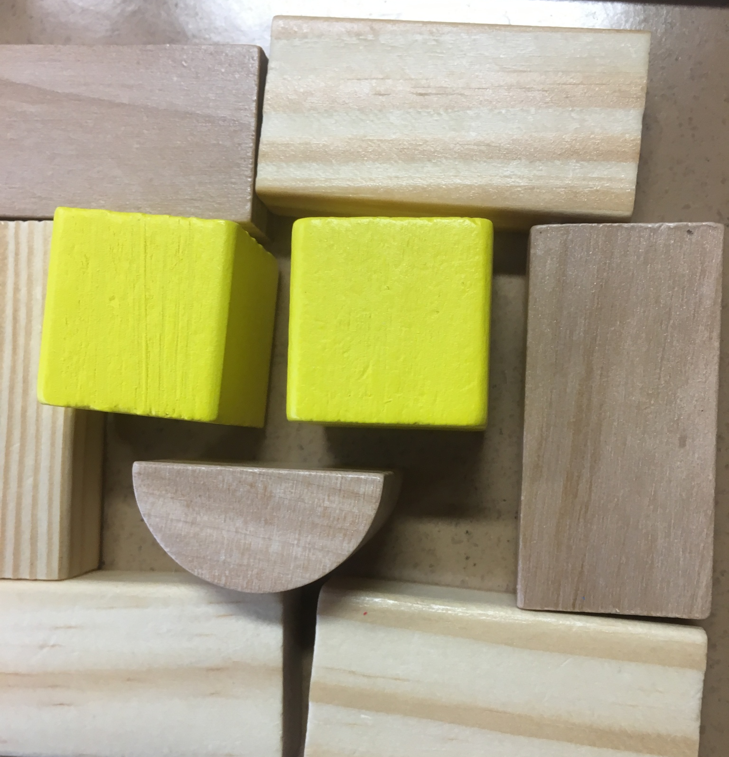
WOODEN BLOCKS

Slide 27
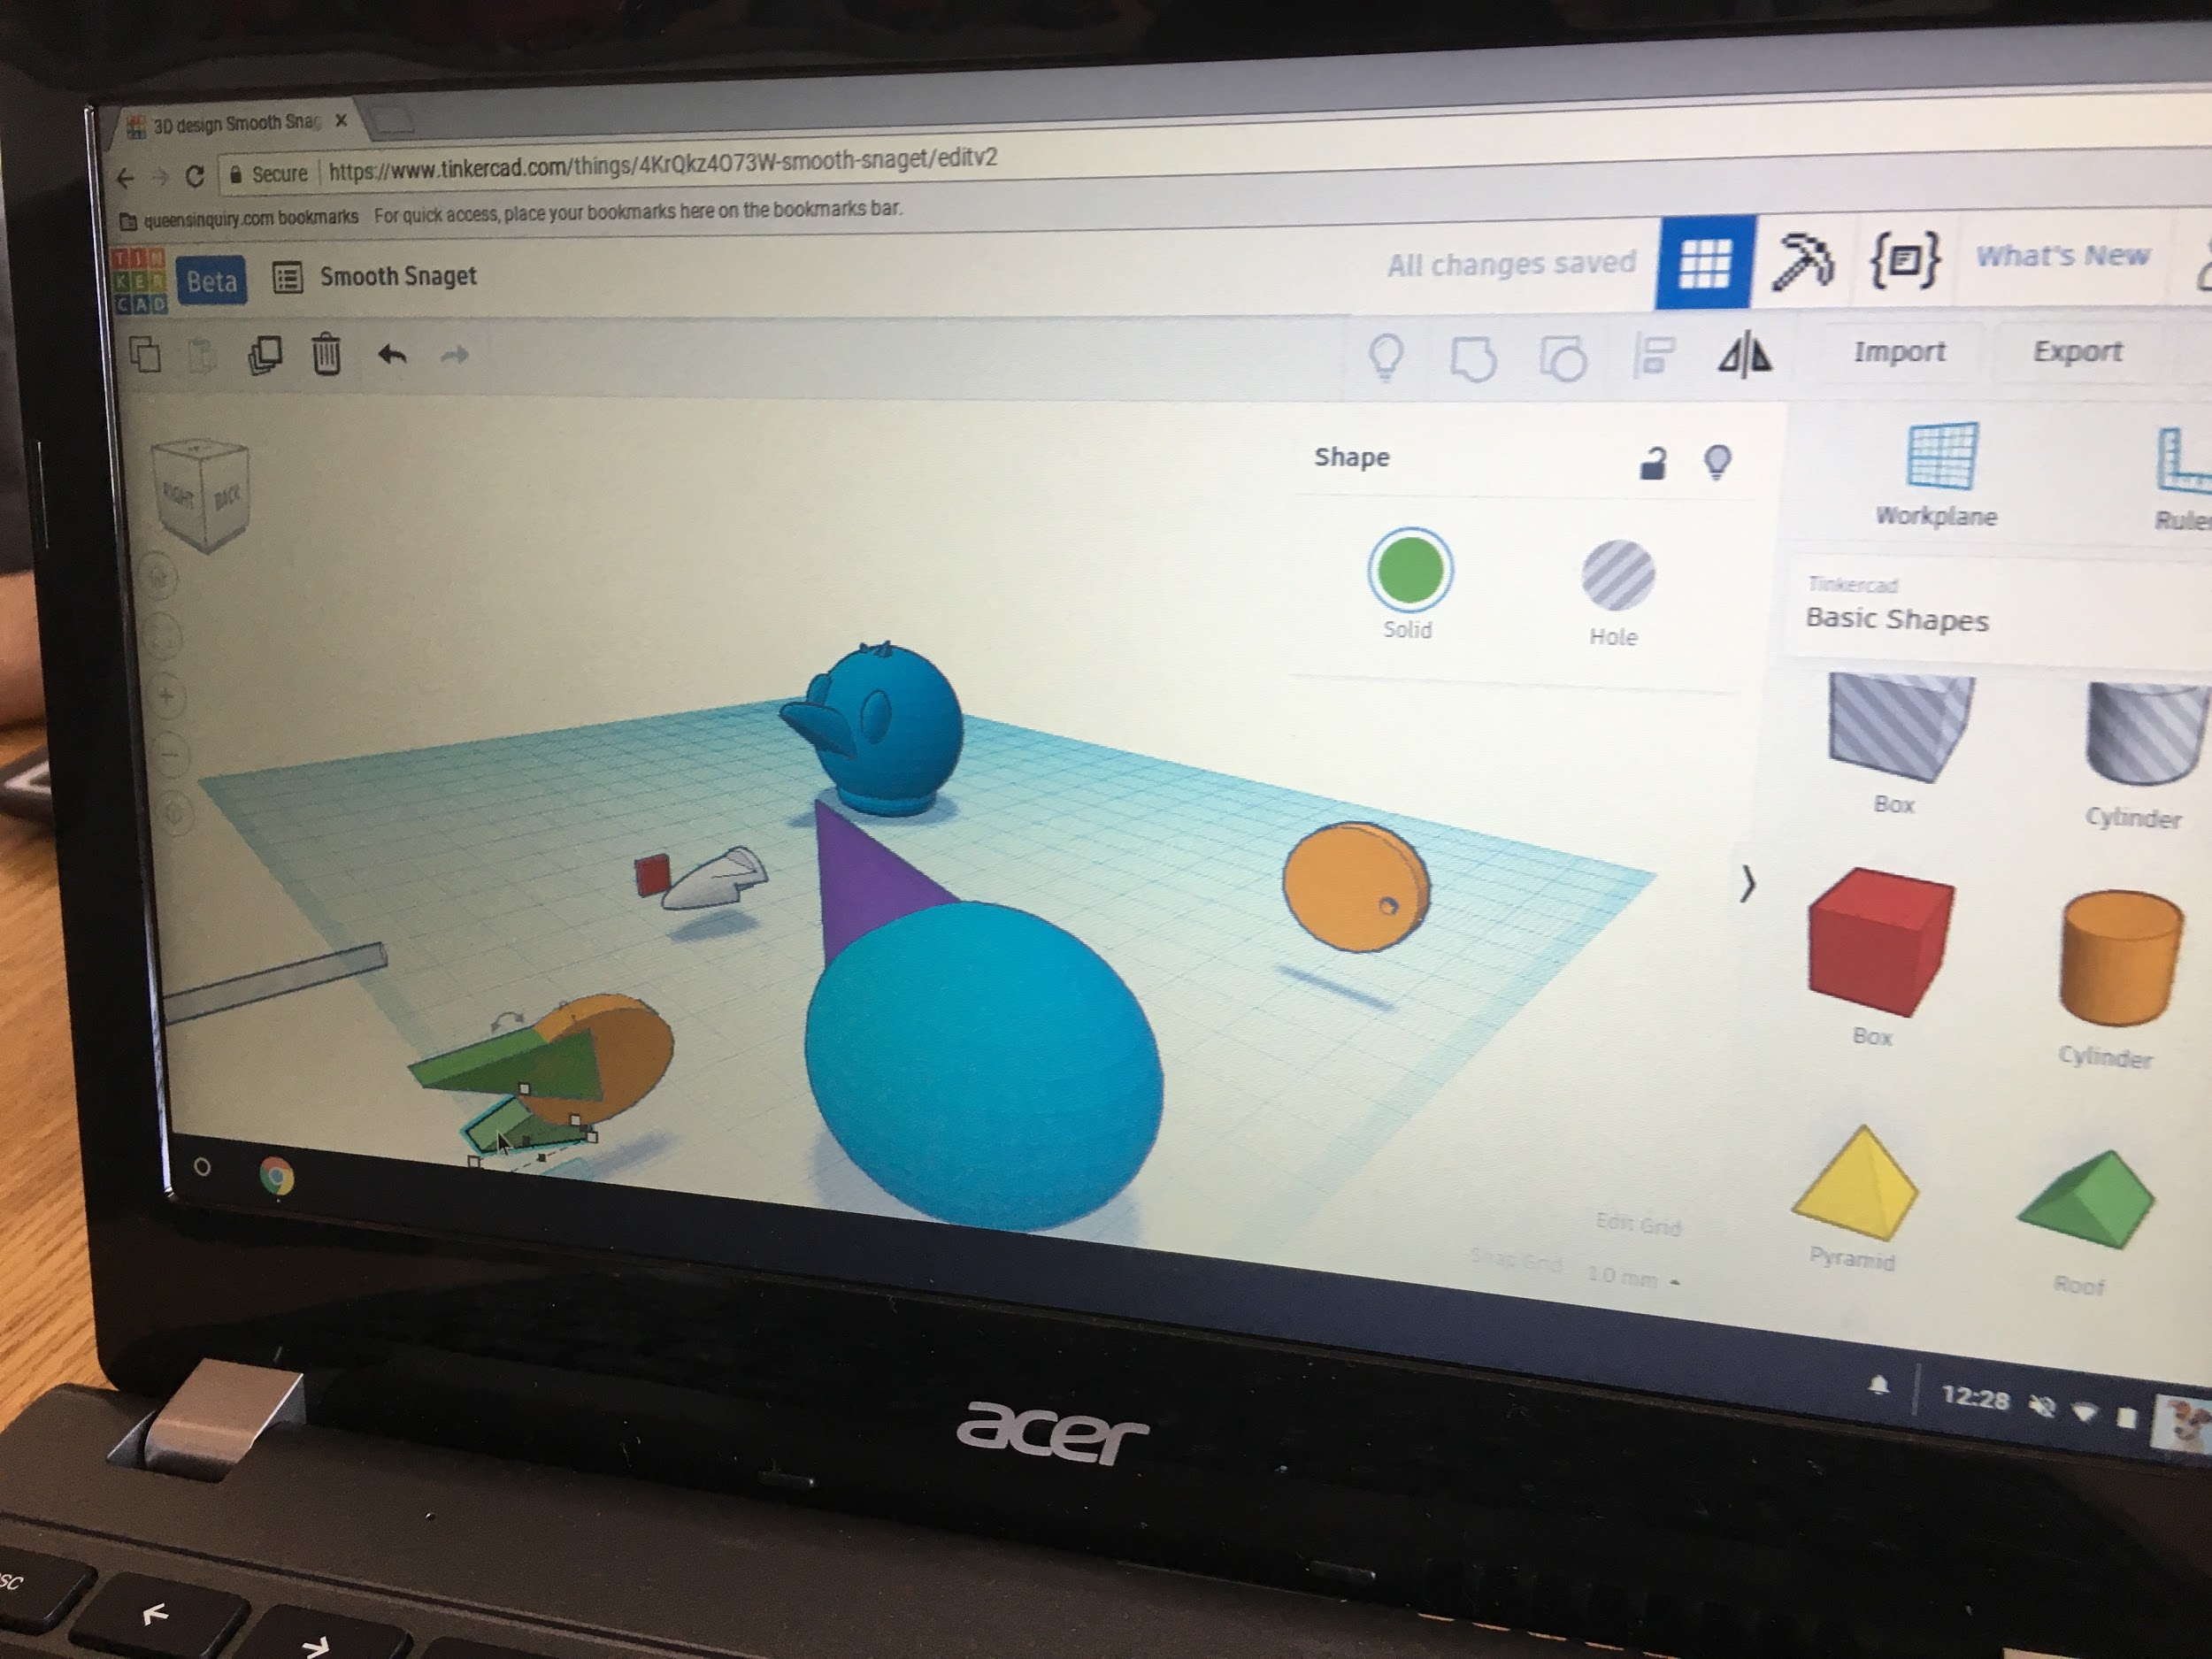
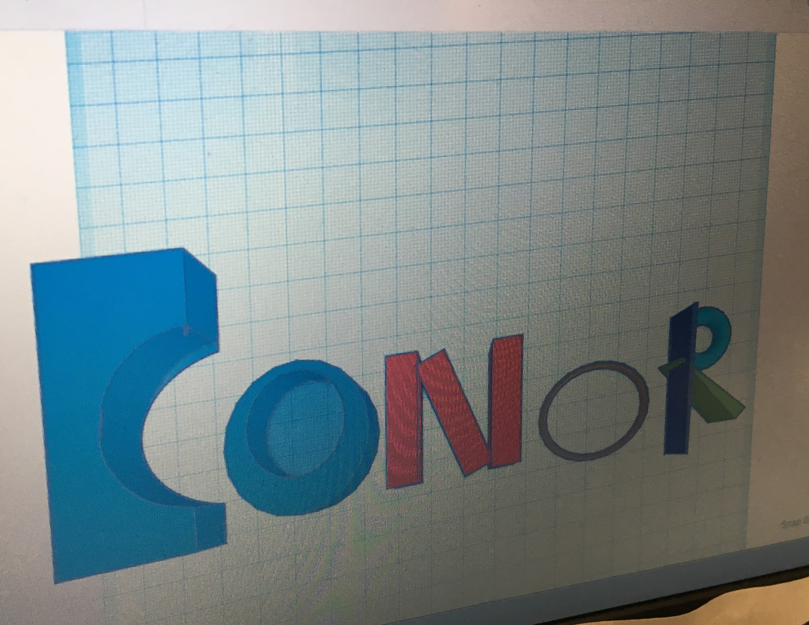
TINKERCAD

Slide 28
CIRCUITS

Slide 29
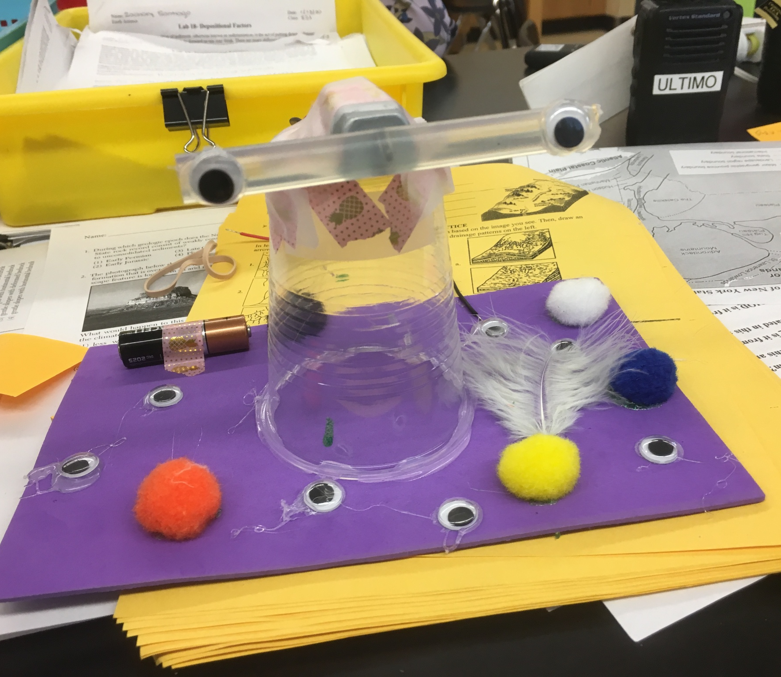
MOTORS

Slide 30
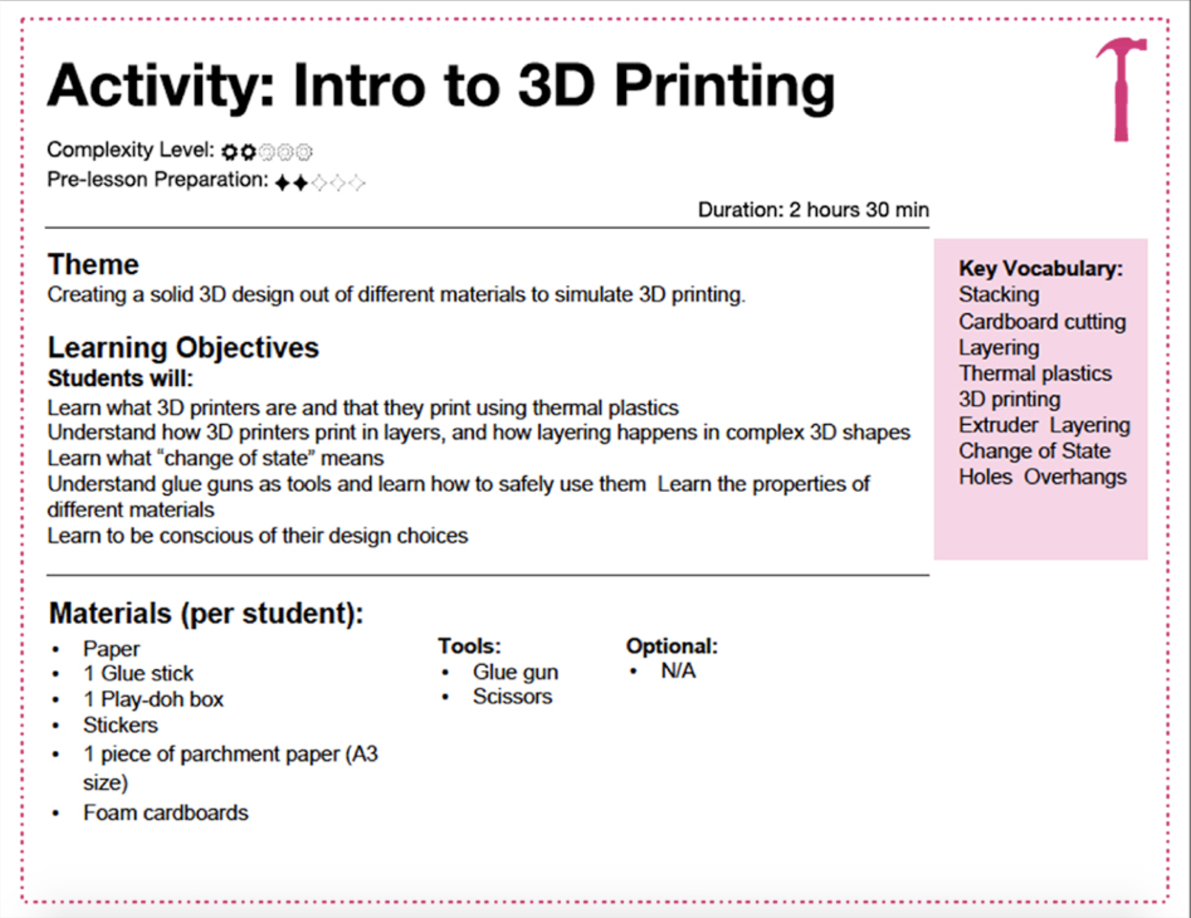
Curriculum Development & Adaptation
The curriculum comes with detailed instructions to facilitate the activities, as well as the following:
A materials list for the specific activity
Information about how to prepare for each lesson, including suggested language to use
Guides and links to videos showing how to facilitate the final project brainstorming discussions
Checklists for supporting executive function
A master materials list to use when ordering materials before the program starts
However, use YOUR maker mindset to adapt the activities to suit you, your environment and your makers!!!

Slide 31
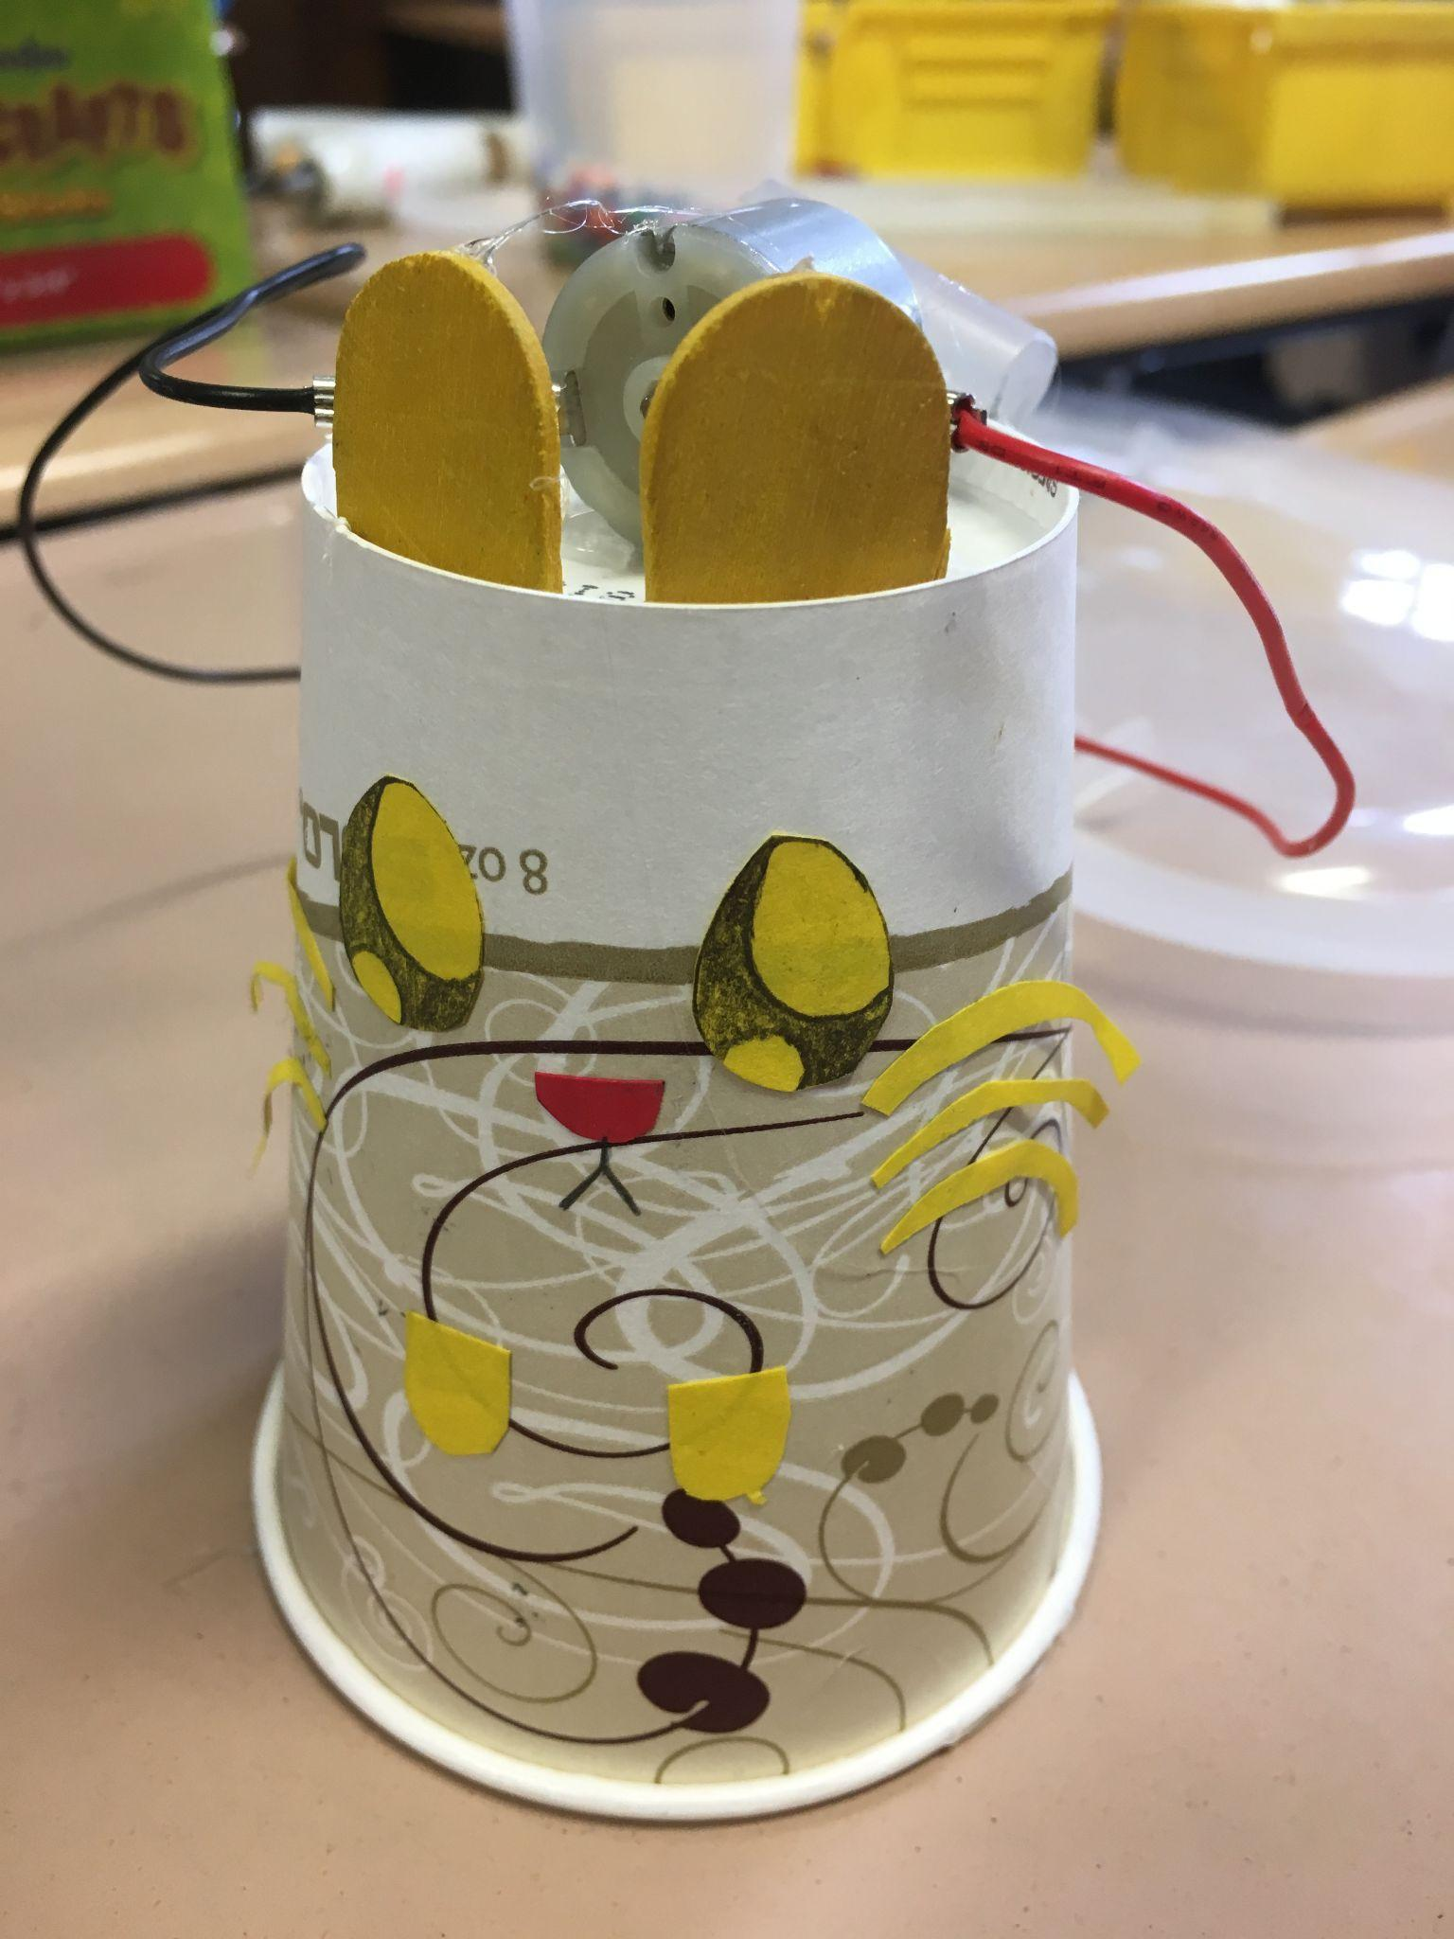
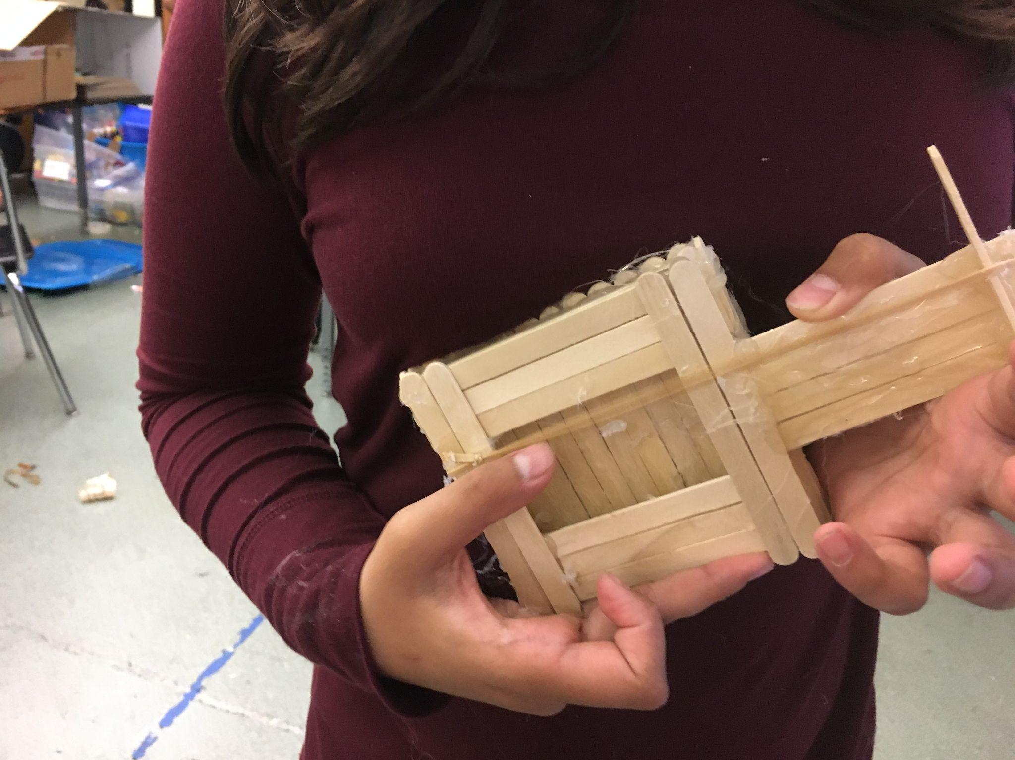
Adaptations we’re making to IDEAS Maker Program
Creating resources better suited for elementary and high school age groups
Making shorter and more targeted activities for occupational therapists
Connecting with additional spaces where youth learn and explore - like libraries!

Slide 32
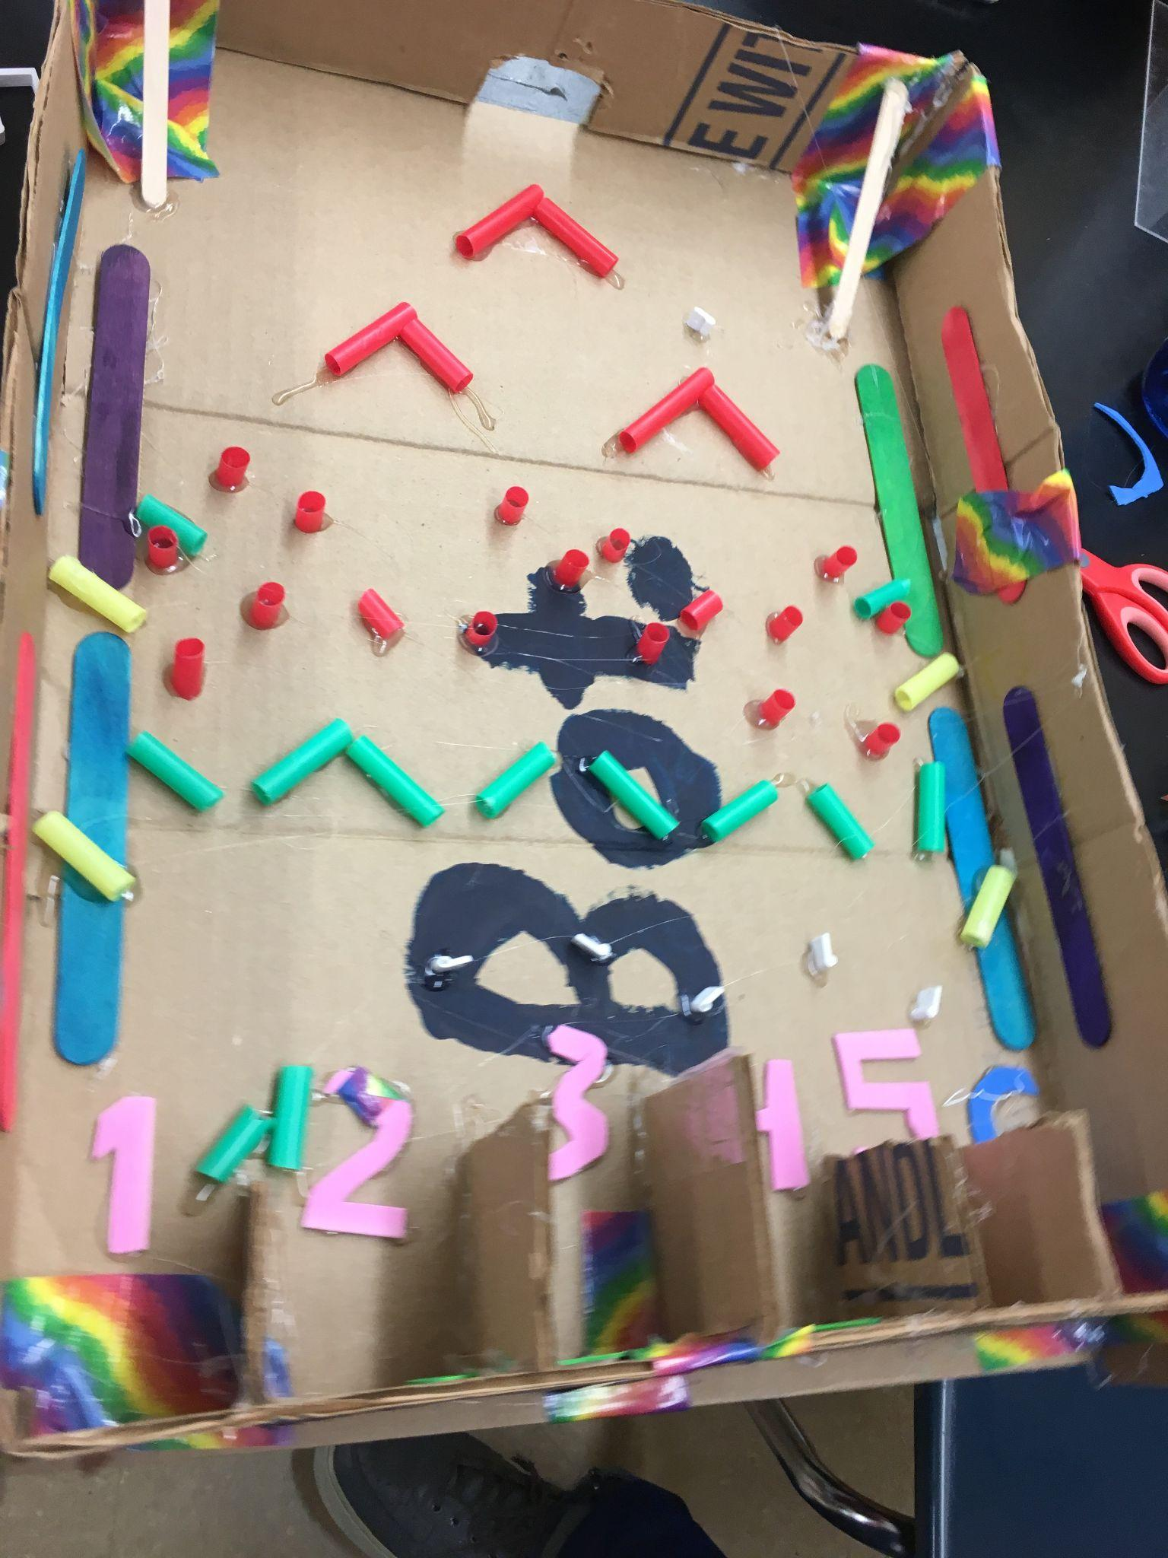
Supports to Implement with Neurodivergent Learners
Consider your space
Consider having quiet spaces available for those with sensory support needs
Use multiple forms of instruction/demonstration including visual references, checklists, step-by-step, guides, verbal instructions, and video supports
Lean into learners’ interests!
Let the makers lead the way

Slide 33
Questions and Discussion
33

Slide 34
One last thing
If you could give just one tip, action step or piece of advice for all the librarians out there, what would it be?
Notes:
Georgette
Thank you so much Ariana, Wendy and Gina for everything you shared today.
I did want to ask you one final question. If you could give just one tip or piece of advice for librarians or anyone attending today, what would it be? After everything we discussed today, Ariana, why don’t you go first?
[Ariana's response]
And Wendy?
[Wendy’s response]
And Gina?
[Gina response]
Thank you all! We’ve just got a couple more slides to share and then we’ll end with contact details to further discussions after today.

Slide 35
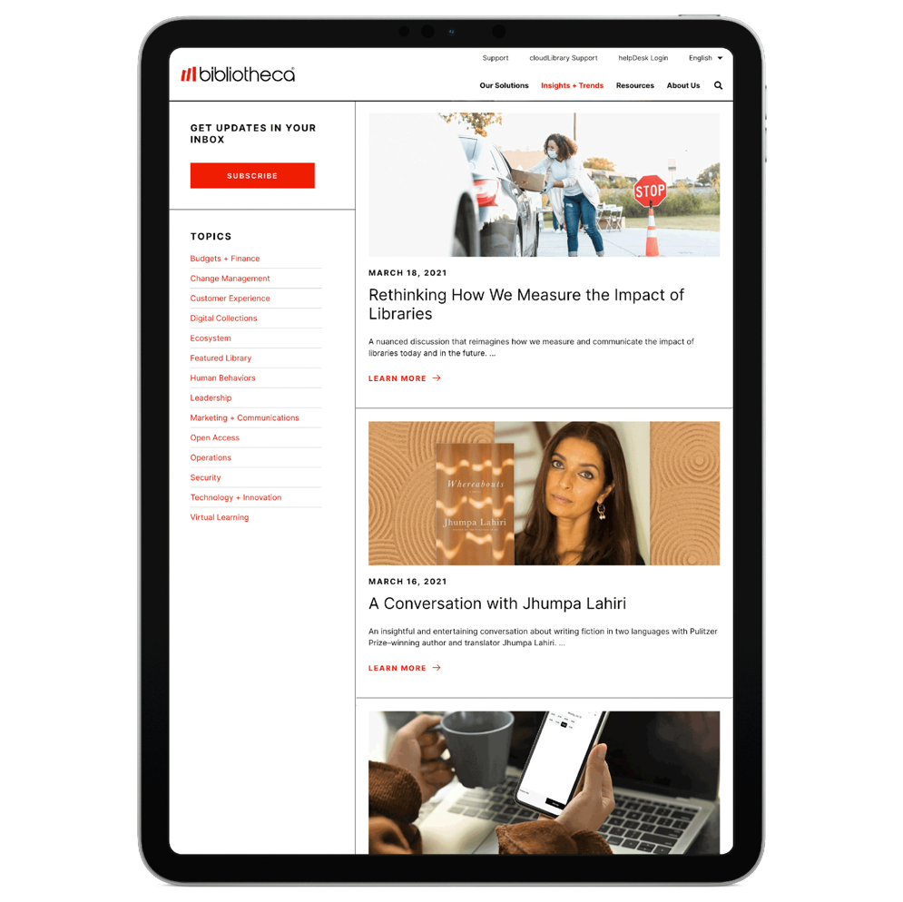
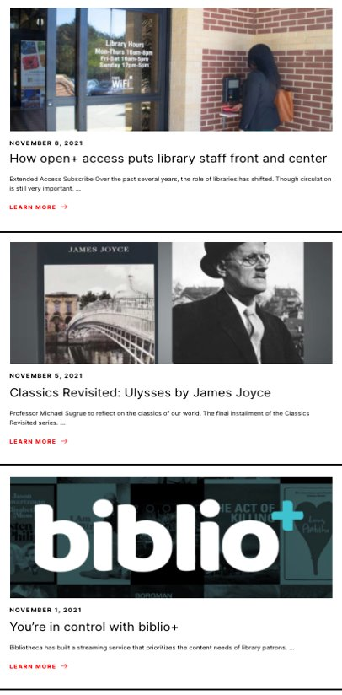
Learn from library leaders around the world
Catch up on-demand and join the discussion live with global leaders: bibliotheca.com
“This was great. I learned a lot, especially about what more I need to learn. The presentation was clear, precise, and at a great level of understanding. Thank you.”
Webinar attendee, 2021
Notes:
Georgette
If you enjoyed today’s webinar, bibliotheca is continually adding to our virtual event line-up. We recently hosted a webinar about The Value of Comics in Libraries: Engaging Readers, Expanding Readership. We have been working on a great series of educational webinars with the Early Development Centre, which have been very well received by our audience and contain many actionable take aways for librarians. And we have a literature series with Professor Sugrue.
We invite you to view all on-demand and upcoming events online at bibliotheca.com and then navigate to our Insights & Trends blog. And make sure you are subscribed to receive webinar updates by navigating the bottom of any page on our website and hitting subscribe.

Slide 36
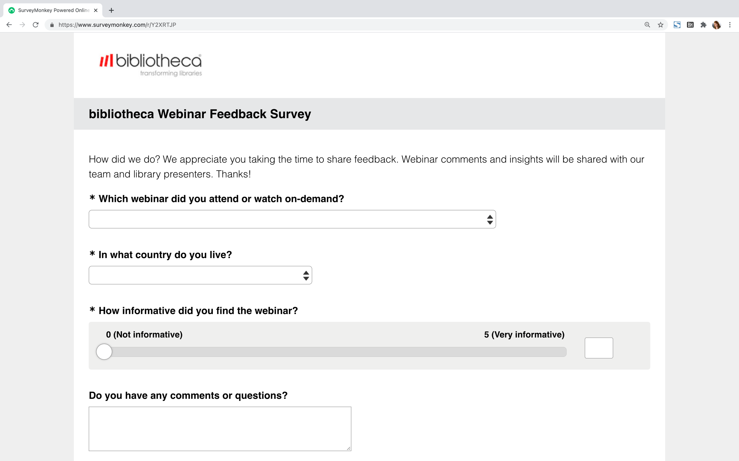
Help shape the future of our digital events!
FEEDBACK SURVEY
THANK YOU
Notes:
Georgette
As we finish today, we would love for everyone to complete a quick survey. If you have any questions, comments, ideas, let us know. We love to hear from you and use your feedback to continually evolve the webinar series we offer to libraries around the world.
Just a reminder – we will circulate the chat log and links to resources in our follow-up email, so keep an eye out for those in your inbox!

Slide 37








Thank you.
"Imagining future library potential, engineering real library solutions“
sales@bibliotheca.com
1.800.328.0067
www.bibliotheca.com
Notes:
Special thanks to Ariana, Wendy and Gina for today’s insightful discussion. If you’d like to continue to conversation, we’ve included contact details above.
From all of us here at bibliotheca, we thank you for joining this webinar and wish you all a wonderful rest of your day!

